Slide 1
KneeBoard
VER. 23.9.21
☝️Click for Update
by Flyingdeuk
GMP ↔️ CJU | GMP ↔️ SHA
GMP ↔️ PUS | GMP ↔️ KIX
CJU ↔️ KWJ | CJU ↔️ PEK
CJU ↔️ CJJ | ICN ↔️ NKG
CJU ↔️ TAE | ICN ↔️ TAO
CJU ↔️ PUS | ICN ↔️ PEK
PUS ↔️ NRT | ICN ↔️ SHE
ICN ↔️ PUS | ICN ↔️ PVG
ICN ↔️ KIX | ICN ↔️ YNJ
ICN ↔️ NRT | ICN ↔️ HGH
ICN ↔️ CTS | ICN ↔️ CXR
ICN ↔️ HND | ICN ↔️ SGN
ICN ↔️ NGO
Welcome PA
Meter/Feet Conversion In Each China Page
Cold Temp Correction
Cold Wx Operation
ENG ON Deicing | ENG OFF Deicing

Slide 2
WELCOME 방송
손님 여러분, 안녕하십니까? 저는 기장 ___입니다. 저희 대한항공을 이용해 주셔서 대단히 감사합니다 ___ (국제)공항까지 비행시간은 ___시간 ___분 으로 예상됩니다. 비행 중에는 항공기가 갑자기 흔들릴 수도 있으니, 자리에 않아 계실 때에는 항상 좌석벨트를 매주시기 바랍니다. 저는 여러분을 안전하게 모시기 위해 최선을 다하겠습니다. 감사합니다.
Good morning (afternoon /evening), ladies and gentlemen. This is captain last name speaking. Welcome aboard Korean Air. This flight is bound for ___(international) airport and our flight time is ___ hours(s) and minutes. For your safety, keep your seatbelts fastened while you are seated. Thank you for choosing Koreanair. Please enjoy the flight.
RKSS | 서울/김포국제 | ZSSS | 상하이/홍차오
RKSI | 서울/인천국제 | ZSNJ | 난징/루커우
RKPC | 제주국제 | ZSQD | 칭다오/자오동
RKPK | 부산/김해국제 | ZBAA | 베이징/소우뚜(캐피털)
RKTU | 청주국제 | ZYTX | 선양/탸오쎈
RKJJ | 광주 | ZSPD | 상하이/푸동
RKTN | 대구국제 | ZYYJ | 옌지
RJBB | 오사카/간사이 | ZSHC | 황저우/샤오산
RJTT | 도쿄/하네다 | VVCR | 나짱/깜라인
RJAA | 도쿄/나리타 | VVTS | 호찌민/탄소넛
RJCC | 삿포로/신(뉴) 치토세
RJGG | 나고야/주부(센트레아)
Home
도착 방송 Next Page

Slide 3
도착 방송 (5시간이상, 40분전)
손님 여러분, 저는 기장입니다. 우리 비행기는 앞으로 약 ___분 후에 목적지(___국제공항)에 착륙 예정입니다. 현재 공항의 날씨는 ◐___, 기온은 섭씨 __도 입니다.
◐ 맑으며 ◐ (다소)흐리며 ◐ (이슬)비가 내리며/소나기가 내리며 ◐ 바람이 불고 있으며 |  | ◐ 눈이 오고 있으며 ◐ 안개가 끼어 있으며 ◐ 황사가 있으며
지금 이곳의 시각은 __월 __일 __요일, 오전(오후) __시 __분 입니다. 감사합니다.
Ladies and gentlemen, this is the captain speaking. We expect to land at __ international airport in about (40) minutes. The current temperature at ___ is __ degrees Celsius, or __ degrees Fahrenheit (OPT 참고) and it is ◐___.
◐ (mostly) clear ◐ (partly) cloudy ◐ drizzling / raining ◐ windy | ◐ snowing ◐ foggy ◐ hazy or smoggy
The current time is __ : __ a.m(p.m), on (day-of-the-week), (month)(date). Thank you for flying with us today.
Home

Slide 4

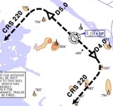
RKSS(GMP) 59ft | RKPC(CJU) 119ft
KE GMP 131.15 DCL -15분 가능 TOBT 5분 차이시 CTC Comm | KE CJU 129.4
Rwy 32R Takeoff
(06:00L~0900L / 12:00L~15:00L /18:00L~21:00L)
GMP : SID (NADP 1)
32L/R | BULTI xT |  | 324 |  | 324 |  | 5000 |  | 324
 | (BULTI xQ) |  | 324 |  | 324 |  | 5000 |  | 324
14L/R | BULTI xU |  | 144 |  | 144 |  | 6000 |  | 144
 | (BULTI xZ) |  | 144 |  | 144 |  | 6000 |  | 144
KIP 113.6 |  | 32L 108.3 | 32R 110.7 |  |  | 14L 109.9 |  | 14R 108.7
32L/R : KIP324/5, R220 YJU R271 |  |  |  | 14L/R : KIP144/4, R220 P73 /2
HUD |  | 32L(41’) |  | 10499’ |  |  | 14R(34’)
 |  | 32R(42’) |  | 11811’ |  |  | 14L(38’)
APRON(130.875) -> GND(121.9) -> TWR (All by ATC)
Home
CJU : STAR AFT Merge PT(220kts) DCT IAF(210kts), FAF (160kts)
ILS Z 07 | DOTOL xP |  | YUMIN |  | DOTOL 160
ILS Z 25 | DOTOL xT |  | DUKAL |  | DOTOL/-10 160
HUD |  | 07(87’) |  | 10433’ |  | 25(76’)
07 : P6(5176’), P5(5882’), P4(6840’-ATC HIRO) 25 : P7(5219’), P8(5882’), P10(7524’-ATC HIRO)
Entering Rapid TWY CTC GND 121.675 (STOP x) HST 40KTS

Slide 5

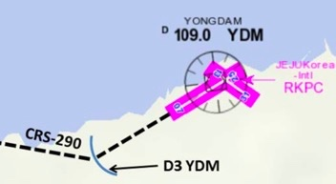
RKPC(CJU) 119ft | RKSS(GMP) 59ft
KE CJU 129.4 DCL -10분 | KE GMP 131.15
Rwy 32L Landing
(06:00L~0900L / 12:00L~15:00L /18:00L~21:00L)
CJU : SID (NADP 1)
07 | KAMIT xE |  |  | 066 |  | 066 |  | 10000 | 066
25 | KAMIT xW |  |  | 246 |  | 246 |  | 10000 | 246
YDM 109.0 |  |  | 07 109.9 |  |  |  | 25 111.3
07 : NONE |  |  |  |  | 25 : YDM246/3, R290
HUD |  | 07(87’) |  |  | 10433’ |  |  | 25(76’)
07 : Passing G4 CTC TWR 25 : 31 Holding PSN on P, E1,2,3 CTC TWR
Home
GMP : STAR
ILS 32L/R | OLMEN xT | OLMEN xT | BUMSI | OLMEN 160
ILS 14R | OLMEN xU | OLMEN xU | DOKDO | OLMEN 160
HUD |  | 32L(41’) | 10499’ | 14R(34’)
 |  | 32R(42’) | 11811’ | 14L(38’)
FIX | KIP /8(RWY 32), YJU R271, P73 /2
32L : D3(6532’), E2(9117’), 32R : E1(6614’) 14R : C1(6578’)
32L/R : 8 KIP L/G, 14R : LOC CAPT L/G FAF : Final Flap TWR -> GND -> APRON (All by ATC) Except RWY14R Landing (Until R)

Slide 6
RKSS(GMP) 59ft | RKPK(PUS) 13ft
KE GMP 131.15 DCL -15분 가능 TOBT 5분 차이시 CTC Comm | KE Gimhae 129.2
Rwy 32R Takeoff
(06:00L~0900L / 12:00L~15:00L /18:00L~21:00L)
GMP : SID (NADP 1)
32L/R | OSPOT xT |  | 324 |  | 324 |  | 5000 |  | 324
 | (OSPOT xQ) |  | 324 |  | 324 |  | 5000 |  | 324
14L/R | OSPOT xU |  | 144 |  | 144 |  | 6000 |  | 144
 | (OSPOT xZ) |  | 144 |  | 144 |  | 6000 |  | 144
KIP 113.6 |  | 32L 108.3 | 32R 110.7 |  |  | 14L 109.9 |  | 14R 108.7
32L/R : KIP324/5, R220 YJU R271 |  |  |  | 14L/R : KIP144/4, R220 P73 /2
HUD |  | 32L(41’) |  | 10499’ |  |  | 14R(34’)
 |  | 32R(42’) |  | 11811’ |  |  | 14L(38’)
APRON(130.875) -> GND(121.9) -> TWR (All by ATC)
Home
PUS : STAR (Tail Wind 36R 136000lbs F40)
ILS 36 | KEVOX x | MASTA | 9DME LG, 8DME FLAP
VOR 18 | GAYHA x | MASTA | 18 Circling Click!!
HUD | 36L(13’) 10499’ 36R(8’) 8999’ |  | 18R(13’) 8530’ 18L(13’) 8999’
FIX | 36 : IKMA/IKHE /9, /8 |  | 18 : KMH R283, R280
36L : C4 (6299’), C2(7795’) / 36R : E3(5866’), E2(7339’) 18R : C6(5770’), C7 (6824’) / 18L : E4(5882’), E5(8792’)
Vacate C3,C4 by ATC only. Max Taxi SPD 20KTS C2 HOLD SHORT 가까움(Vacate TaxiSPD)

Slide 7
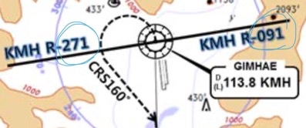
RKPK(PUS) 13ft | RKSS(GMP) 59ft
KE Gimhae 129.2 DCL -5분 | KE GMP 131.15
Rwy 32L Landing
(06:00L~0900L / 12:00L~15:00L /18:00L~21:00L)
PUS : SID (Mod NADP CLB2 1000, 14000 MAX)
36 | SOORO x KALOD tx |  |  | 306 |  | 280 |  | ATC |  | 342
18 | GIMHAE x |  |  | 182 |  | 182 |  | 5000 |  | 182
KMH 113.8 |  |  | PSN 114.0 |  | 36L 108.5 |  |  |  | 36R 109.5
36 : KMH R091, R271, R185
HUD |  | 36L(13’) 10499’ 36R(8’) 8999’ |  |  |  |  | 18R(13’) 8530’ 18L(13’) 8999’
RWY36 400ft Man L/H turn, Max Taxi SPD 20KTS
Home
GMP : STAR
ILS 32L/R |  | GUKDO xT | BUMSI | GUKDO 160
ILS 14R |  | GUKDO xU | DOKDO | GUKDO 160
HUD |  | 32L(41’) | 10499’ | 14R(34’)
 |  | 32R(42’) | 11811’ | 14L(38’)
FIX | KIP /8(RWY 32), YJU R271, P73 /2
32L : D3(6532’), E2(9117’), 32R : E1(6614’) 14R : C1(6578’)
32L/R : 8 KIP L/G, 14R : LOC CAPT L/G FAF : Final Flap TWR -> GND -> APRON (All by ATC) Except RWY14R Landing (Until R)

Slide 8

RKPC(CJU) 119ft | RKJJ(KWJ) 48ft
KE CJU 129.4 DCL -10분 | KE KWJ 129.4
CJU : SID (NADP 1)
07 | KAMIT xE |  |  | 066 |  | 066 |  | 10000 | 066
25 | KAMIT xW |  |  | 246 |  | 246 |  | 10000 | 246
YDM 109.0 |  |  | 07 109.9 |  |  |  | 25 111.3
07 : NONE |  |  |  |  | 25 : YDM246/3, R290
HUD |  | 07(87’) |  |  | 10433’ |  |  | 25(76’)
07 : Passing G4 CTC TWR 25 : 31 Holding PSN on P, E1,2,3 CTC TWR
Home
KWJ : NO STAR (TL 140확인) – STAR RNP app Only!!
ILS 04R | no KOTTY | SAMUL/-15 |  | CI04R
LOC 22L | SAMUL | D058Q |  | No PAR 3.3도
VOR 22L/R | SAMUL | D058Q |  | Offset 3.29도
HUD | 04R(46’) |  | 9301’ | 22L(48’)
 | 04L(46’) |  | 9301’ | 22R(48’)
FIX | 04R : SAMUL(CLR Limit)
End of RWY Vacating 9301’
LOC 22L, VOR 22L/R -> LOC/VOR LNAV 지시고도 유지후 Final Establish 이후 강하 (TERR!!) PAR 04L/R, 22R 가능 : 강하각 3도 (6NM, 3도) TAXI MAX 15 kts (Max 30kts by ATC)

Slide 9
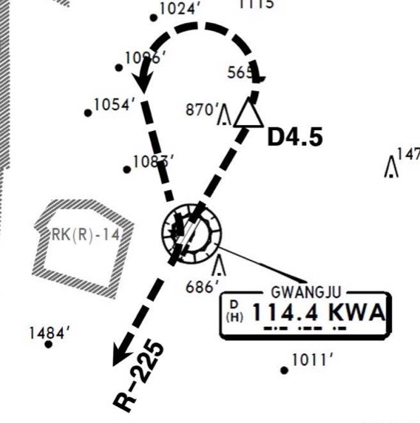
RKJJ(KWJ) 48ft | RKPC(CJU) 119ft
KE KWJ 129.4 NO DCL | KE CJU 129.4
KWJ : SID (NADP 1)
ALL | KWA 5 |  |  |  |  |  |  | 8000
04L | (GWJ 3) |  |  | 038 |  | 038 |  | ATC | 038
22R | (GWJ 4) |  |  | 218 |  | 218 |  | ATC | 218
KWA 114.4 |  |  | 04R 111.1 |  |  |  | 22L 108.5
04 : KWA /4.5, R225 |  |  |  |  | 22 : None
HUD |  | 04L(46’) |  |  | 9301’ |  |  | 22R(48’)
 |  | 04R(46’) |  |  | 9301’ |  |  | 22L(48’)
Taxi SPD MAX 15kts MAX 30kts by ATC
Home
CJU : STAR AFT Merge PT(220kts) DCT IAF(210kts), FAF (160kts)
ILS Z 07 | DOTOL xP |  | YUMIN |  | DOTOL 160
ILS Z 25 | DOTOL xT |  | DUKAL |  | DOTOL/-10 160
HUD |  | 07(87’) |  | 10433’ |  | 25(76’)
07 : P6(5176’), P5(5882’), P4(6840’-ATC HIRO) 25 : P7(5219’), P8(5882’), P10(7524’-ATC HIRO)
Entering Rapid TWY CTC GND 121.675 (STOP x) HST 40KTS

Slide 10
RKPC(CJU) 119ft | RKTU(CJJ) 192ft
KE CJU 129.4 DCL -10분 | KE CJJ 129.05 NO DCL, ATIS
CJU : SID (NADP 1)
07 | KAMIT xE |  |  | 066 |  | 066 |  | 10000 | 066
25 | KAMIT xW |  |  | 246 |  | 246 |  | 10000 | 246
YDM 109.0 |  |  | 07 109.9 |  |  |  | 25 111.3
07 : NONE |  |  |  |  | 25 : YDM246/3, R290
HUD |  | 07(87’) |  |  | 10433’ |  |  | 25(76’)
07 : Passing G4 CTC TWR 25 : 31 Holding PSN on P, E1,2,3 CTC TWR
Home
CJJ : NO STAR After OSPOT H/D060 – RDR Vector Req ILS Z 24R via HYEIN
ILS Z 06L | NO STAR (MATIZ x) |  | OSPOT (JIKJI tx) | TU761 / BAKJO (STAR 안줌)
ILS Z 24R | NO STAR (MATIZ x) |  | OSPOT (HYEIN tx) | HYEIN (STAR 안줌)
HUD |  | 06L(166’) | 9003’ | 24R(182’)
 |  | 06R(173’) | 9003’ | 24L(191’)
FIX
06L : B3 (6443’), A3 (8786’) 24R : C3 (6230’), D3 (8825’)
GS fluc’ - A/P Dis’ – Back to Normal – A/P Reengage Req full length Landing (Vacate End of RWY) 180 BACK LINE 지나 Taxi Line 있음 Entering TWY A3, B3, B4, C3, D3 change GND freq

Slide 11
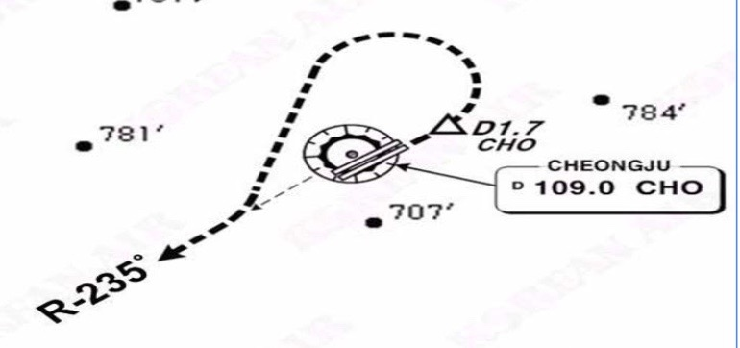
RKTU(CJJ) 192ft | RKPC(CJU) 119ft
KE CJJ 129.05 NO DCL, ATIS | KE CJU 129.4
CJJ : SID (NADP 1)
06L | CJJ xD |  |  | 060 |  | 060 | 6000 | 060
24R | CJJ xD |  |  | 240 |  | 240 | 6000 | 240
(06L : BUKIL 1, 2 RNAV) |  |  |  |  |  | (24R : OLREG 1, UPTIL 1)
CHO 109.0 |  |  | 06L 110.3 |  |  |  | 24R 111.7
06L/R : CHO /1.7, R235 |  |  |  |  | 24L/R : None
HUD |  | 06L(166’) |  |  | 9003’ |  | 24R(182’)
 |  | 06R(173’) |  |  | 9003’ |  | 24L(191’)
Upslope from Apron to RWY Entering TWY A3, B3, B4, C3, D3 change TWR freq
Home
CJU : STAR AFT Merge PT(220kts) DCT IAF(210kts), FAF (160kts)
ILS Z 07 | DOTOL xP |  | YUMIN |  | DOTOL 160
ILS Z 25 | DOTOL xT |  | DUKAL |  | DOTOL/-10 160
HUD |  | 07(87’) |  | 10433’ |  | 25(76’)
07 : P6(5176’), P5(5882’), P4(6840’-ATC HIRO) 25 : P7(5219’), P8(5882’), P10(7524’-ATC HIRO)
Entering Rapid TWY CTC GND 121.675 (STOP x) HST 40KTS

Slide 12
RKPC(CJU) 119ft | RKTN(TAE) 120ft
KE CJU 129.4 DCL -10분 | KE TAE 129.2
CJU : SID (NADP 1)
07 | AKPON xE |  |  | 066 |  | 066 |  | 9000 | 066
25 | AKPON xW |  |  | 246 |  | 246 |  | ATC | 246
YDM 109.0 |  |  | 07 109.9 |  |  |  | 25 111.3
07 : NONE |  |  |  |  | 25 : YDM246/3, R290
HUD |  | 07(87’) |  |  | 10433’ |  |  | 25(77’)
07 : Passing G4 CTC TWR 25 : 31 Holding PSN on P, E1,2,3 CTC TWR
Home
TAE : NO STAR (TL 140 확인)
ILS 31L | TGU/-10 |  |  | CF31L222/7 |  | CF31L
ILS 13R | TGU/-10 |  |  | YAWAN
HUD |  |  | 31L(118’) | 9039’ | 13R(111’) 3.3
 |  |  | 31R(120’) | 8999’ | 13L(112’)
FIX
31L : D1(8848’), 13R : A1(8772’)
13R ILS 3.3도 PAPI 3.3도 (산악지형 주의) TAXI MAX 20kts (do not req) 최소 2000ft 간격

Slide 13
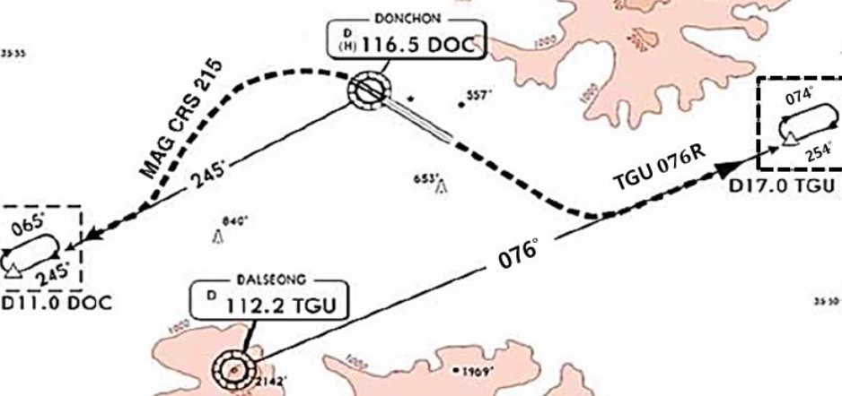
RKTN(TAE) 120ft | RKPC(CJU) 119ft
KE TAE 129.2 NO DCL | KE CJU 129.4
TAE : SID (NADP 1)
31L/R | DAEGU xD |  |  | 312 |  | 312 | 8000 |  | 192
13L/R | DAEGU xD |  |  | 132 |  | 132 | 8000 |  | 192
DOC 116.5 |  |  | TGU 112.2 |  |  | 31L 108.7 |  | 13R 108.7
31 : DOC 245/11 DOC R245 |  |  |  |  | 13 : TGU076/17 TGU R076
HUD |  | 31L(118’) |  |  | 9039’ |  | 13R(112’) 3.3
 |  | 31R(120’) |  |  | 8999’ |  | 13L(112’)
TAXI MAX 20kts (do not req) 최소 2000ft 간격
Home
CJU : STAR AFT Merge PT(220kts) DCT IAF(210kts), FAF (160kts)
ILS Z 07 | UPGOS xP | YUMIN
ILS Z 25 | UPGOS xT | DUKAL
HUD | 07(87’) | 10433’ | 25(76’)
07 : P6(5176’), P5(5882’), P4(6840’-ATC HIRO) 25 : P7(5219’), P8(5882’), P10(7524’-ATC HIRO)
Entering Rapid TWY CTC GND 121.675, STOP X HST 40KTS

Slide 14
RKPC(CJU) 119ft | RKPK(PUS) 13ft
KE CJU 129.4 DCL -10분 | KE Gimhae 129.2
CJU : SID (NADP 1)
07 | AKPON xE |  |  | 066 |  | 066 |  | 9000 | 066
25 | AKPON xW |  |  | 246 |  | 246 |  | ATC | 246
YDM 109.0 |  |  | 07 109.9 |  |  |  | 25 111.3
07 : NONE |  |  |  |  | 25 : YDM246/3, R290
HUD |  | 07(87’) |  |  | 10433’ |  |  | 25(76’)
07 : Passing G4 CTC TWR 25 : 31 Holding PSN on P, E1,2,3 CTC TWR
Home
PUS : STAR (Tail Wind 36R 136000lbs F40)
ILS 36 | KEVOX x | ANROD | 9DME LG, 8DME FLAP
VOR 18 | GAYHA x | ANROD | 18 Circling Click!!
HUD | 36L(13’) 10499’ 36R(8’) 8999’ |  | 18R(13’) 8530’ 18L(13’) 8999’
FIX | 36 : IKMA/IKHE /9, /8 |  | 18 : KMH R283, R280
36L : C4 (6299’), C2(7795’) / 36R : E3(5866’), E2(7339’) 18R : C6(5770’), C7 (6824’) / 18L : E4(5882’), E5(8792’)
Vacate C3,C4 by ATC only. Max Taxi SPD 20KTS C2 HOLD SHORT 가까움(Vacate TaxiSPD)

Slide 15
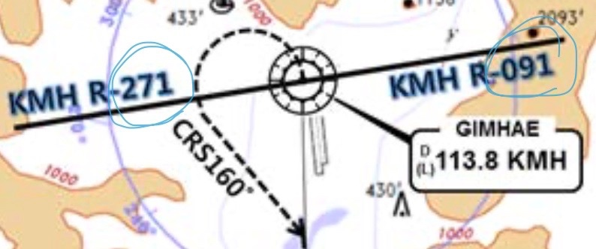
RKPK(PUS) 13ft | RKPC(CJU) 119ft
KE Gimhae 129.2 DCL -5분 | KE CJU 129.4
PUS : SID (Mod NADP CLB2 1000, 14000 MAX)
36 | SOORO x TOPAX tx |  |  | 306 |  | 280 |  | ATC |  | 279
18 | BULIM x ENGOT tx |  |  | 182 |  | 182 |  | 5000 |  | 182
KMH 113.8 |  |  | PSN 114.0 |  | 36L 108.5 |  |  |  | 36R 109.5
36 : KMH R091, R271, R185
HUD |  | 36L(13’) 10499’ 36R(8’) 8999’ |  |  |  |  | 18R(13’) 8530’ 18L(13’) 8999’
RWY36 400ft Man L/H turn, Max Taxi SPD 20KTS
Home
CJU : STAR AFT Merge PT(220kts) DCT IAF(210kts), FAF (160kts)
ILS Z 07 | UPGOS xP | YUMIN
ILS Z 25 | UPGOS xT | DUKAL
HUD | 07(87’) | 10433’ | 25(76’)
07 : P6(5176’), P5(5882’), P4(6840’-ATC HIRO) 25 : P7(5219’), P8(5882’), P10(7524’-ATC HIRO)
Entering Rapid TWY CTC GND 121.675, STOP X HST 40KTS

Slide 16
RKPK(PUS) 13ft | RJAA(NRT) 135ft
KE Gimhae 129.2 DCL -5분 | KE Tokyo 131.7
PUS : SID (Mod NADP CLB2 1000, 14000 MAX)
36 | SOORO x PSN tx |  |  | 306 |  | 280 |  | ATC |  | 162
18 | BULIM x PSN tx |  |  | 182 |  | 182 |  | 5000 |  | 182
KMH 113.8 |  |  | PSN 114.0 |  | 36L 108.5 |  |  |  | 36R 109.5
36 : KMH R091, R271, R185
HUD |  | 36L(13’) 10499’ 36R(8’) 8999’ |  |  |  |  | 18R(13’) 8530’ 18L(13’) 8999’
RWY 36 400ft Man L/H turn, Max Taxi SPD 20KTS
Home
DEP 125.5 – TGU 125.37
FUK 133.15 – TKO 133.8 – 133.02 – 132.45 -124.1
TKO 128.2 – TKO APP 124.4
NRT HAKKA 330,YAGAN 240,LIVET 210,SWAMP 150 Prepare Holding or RWY CHG
34L/R | SWAMP E (SWAMP T) | ELGAR (TYLER) | ILS 34L/R(Z)
16L/R | SWAMP G (SWAMP N) | GEMIN (NORMA) | ILS Z 16L/R
HUD | 16L(135’) | 8202’ | 34R(141’)
 | 16R(130’) | 13123’ | 34L(139’)
FIX | 16L : ITM 4 / 34R : ITJ 14, 4 (DME) 16R : IKF 4 / 34L : IYQ 12, 4 (DME)
16L : B6(6433’), B7(7017’), 34R : B4(5849’), B2(6778’) 16R : A6(6076’), A7(7624’), 34L : A5(6167’), A4(7641’)
L/D DOWN before 14/12 DME, L/D FLAP 4 DME Arrival Taxi RTE in Jeppesen (No Numbering)

Slide 17
RJAA(NRT) 135ft | RKPK(PUS) 13ft
KE Tokyo 131.70 DCL -15분 | KE Gimhae 129.2
NRT : SID – ENPAR tx (NADP 1)
16L/R | TETRA x ENPAR tx |  | 157 |  | 157 | ATC |  | 157
34L/R |  |  | 337 |  | 337 | 7000/ATC |  | 337
NRE 117.9 |  | 16L 110.7 |  | 16R 111.5 |  | 34L 111.9 | 34R 110.9
HUD | 16L(135’) |  | 8202’ |  |  | 34R(141’)
 | 16R (130’) |  | 13123’ |  |  | 34L (139’)
34R : CLB 220/10000, A4R21/22/23 220KTS 확인 Verity ENPAR tx TETRA 12000A APU Start, TAXI RTE 1, 2, 3, 4 RWY 별 DEP RTE
DEP 124.2
TKO 120.5 – 133.45 – 133.02 – 133.8
FUK 133.15
TGU 125.37
APP 125.5
Home
PUS : STAR (Tail Wind 36R 136000lbs F40)
ILS 36 | PEDLO x | KALEK | 9DME LG, 8DME FLAP
VOR 18 | GAYHA x | PSN | 18 Circling Click!!
HUD | 36L(13’) 10499’ 36R(8’) 8999’ |  | 18R(13’) 8530’ 18L(13’) 8999’
FIX | 36 : IKMA/IKHE /9, /8 |  | 18 : KMH R283, R280
36L : C4 (6299’), C2(7795’) / 36R : E3(5866’), E2(7339’) 18R : C6(5770’), C7 (6824’) / 18L : E4(5882’), E5(8792’)
Vacate C3,C4 by ATC only. Max Taxi SPD 20KTS C2 HOLD SHORT 가까움(Vacate TaxiSPD)

Slide 18
RKSI(ICN) 23ft | RKPK(PUS) 13ft
KE ICN 131.5 DCL -10분 TOBT 5분 차이시 CTC Comm | KE Gimhae 129.2
ICN : SID (33/34 NADP 1, 15/16 NADP 2)
33L/R | OSPOT xE/A |  | 333 |  | 333 |  | 5500/ATC |  | 333
34L/R | OSPOT xY |  | 333 |  | 333 |  | ATC |  | 333
15L/R | OSPOT xC |  | 153 |  | 153 |  | 5000 |  | 153
16L/R | OSPOT xH |  | 153 |  | 153 |  | 5000 |  | 153
NCN 113.8 |  | 33L 109.3 |  | 33R 108.9 |  | 15L 111.9 |  | 15R 109.1
WNG 112.9 |  | 34L 109.95 |  | 34R 108.1 |  | 16L 110.35 |  | 16R 108.55
33L/R : NC05L/R, R242 YJU R271 |  |  |  | 34L/R : WNG333/4.6, R242 YJU R271
HUD | 33L/R 34L(23’) |  |  | 12303’ |  | 15L/R 16R(23’)
 | 34R (23’) |  |  | 13123’ |  | 16L (23’)
Parallel TWY 10KTS 이상(R17 MAX 15kts)
Home
PUS : STAR (Tail Wind 36R 136000lbs F40)
ILS 36 | KEVOX x | MASTA | 9DME LG, 8DME FLAP
VOR 18 | GAYHA x | MASTA | 18 Circling Click!!
HUD | 36L(13’) 10499’ 36R(8’) 8999’ |  | 18R(13’) 8530’ 18L(13’) 8999’
FIX | 36 : IKMA/IKHE /9, /8 |  | 18 : KMH R283, R280
36L : C4 (6299’), C2(7795’) / 36R : E3(5866’), E2(7339’) 18R : C6(5770’), C7 (6824’) / 18L : E4(5882’), E5(8792’)
Vacate C3,C4 by ATC only, Max Taxi SPD 20KTS C2 HOLD SHORT 가까움(Vacate TaxiSPD)

Slide 19
RKPK(PUS) 13ft | RKSI(ICN) 23ft
KE Gimhae 129.2 DCL -5분 | KE ICN 131.5
PUS : SID (Mod NADP CLB2 1000, 14000 MAX)
36 | SOORO x KALOD tx |  |  | 306 |  | 280 |  | ATC |  | 342
18 | GIMHAE x |  |  | 182 |  | 182 |  | 5000 |  | 182
KMH 113.8 |  |  | PSN 114.0 |  | 36L 108.5 |  |  |  | 36R 109.5
36 : KMH R091, R271, R185
HUD |  | 36L(13’) 10499’ 36R(8’) 8999’ |  |  |  |  | 18R(13’) 8530’ 18L(13’) 8999’
RWY 36 400ft Man L/H turn, Max Taxi SPD 20KTS
Home
ICN : STAR
ILS 33/34 | GUKDO xE | ENPIL | GUKDO 180
ILS 15/16 | GUKDO xH | MUNAN | GUKDO 180
HUD | 33L/R 34L(23’) | 12303’ | 15L/R 16R(23’)
 | 34R(23’) | 13123’ | 16L(23’)
FIX | RWY /8, /5 , YJU R271
33R : C4(7529’), C5(8513’), 33L : B4(7463’), B5(8513‘) 15L : C2(7522’), C1(8536’), 15R : B3(7454‘), B2(8641‘)
34L : P7(5600’), P8(6578’), 34R : N4(6876’), N5(8507‘) 16R : P6(5597’), P5(6574’), 16L : N3(7043‘), N2(8444‘)
8NM 180kts, 5NM 160kts, Parr TAXI 10kts이상, HIRO

Slide 20
RKSI(ICN) 23ft | RJBB(KIX) 17ft
KE ICN 131.5 DCL -10분 TOBT 5분 차이시 CTC Comm | KE KIX 130.95
ICN : SID (33/34 NADP 1, 15/16 NADP 2)
33L/R | EGOBA xE/A |  | 333 |  | 333 |  | 5500/ATC |  | 333
34L/R | EGOBA xY |  | 333 |  | 333 |  | ATC |  | 333
15L/R | EGOBA xC |  | 153 |  | 153 |  | 5000 |  | 153
16L/R | EGOBA xH |  | 153 |  | 153 |  | 5000 |  | 153
NCN 113.8 |  | 33L 109.3 |  | 33R 108.9 |  | 15L 111.9 |  | 15R 109.1
WNG 112.9 |  | 34L 109.95 |  | 34R 108.1 |  | 16L 110.35 |  | 16R 108.55
33L/R : NC05L/R, R242 YJU R271 |  |  |  | 34L/R : WNG333/4.6, R242 YJU R271
HUD | 33L/R 34L(23’) |  |  | 12303’ |  | 15L/R 16R(23’)
 | 34R (23’) |  |  | 13123’ |  | 16L (23’)
Parallel TWY 10KTS 이상(R17 MAX 15kts)
DEP 125.15 – TGU 134.17 - TKO 133.8
KIX RDR 120.85
KIX APP 120.25
Home
KIX : STAR (SAEKI 170, RANDY 150)
06L | ALISA B | BERRY | ILS Y 06L
06R | ALISA A | ALLAN | ILS Y 06R
24L/R | ALISA C | MAYAH | ILS Z 24L/R
HUD | 06L(15’) 13123’ 24R(23’)
 | 06R(5’) 11483’ 24L(12’)
06L : B8(5160’), B6(6751’), 24R : B7(5318’), B9(6751’) 06R : A7(5137’), A6(6938’), 24L : A8(5269’), A9(6976’)
RWY06 : After 2500ft L/G DN, After 1500ft L/D FLAP TAXI RTE 1, 2

Slide 21
RJBB(KIX) 17ft | RKSI(ICN) 23ft
KE KIX 130.95 DCL -15분 | KE ICN 131.5
KIX : SID – SOUJA tx (NADP 1)
06L/R | HELEN x - SOUJA tx |  | 058 |  | 058 | ATC (9000) |  | 058
24L/R |  |  | 238 |  | 238 | ATC (9000) |  | 238
KIE 111.6 |  | 06L 108.7 |  | 06R 108.1 |  | 24L 110.7 | 24R 108.5
HUD | 06L(15’) |  | 13123’ |  |  | 24R(23’)
 | 06R (5’) |  | 13123’ |  |  | 24L (12’)
APU Start, TAXI RTE 1, 2
DEP 119.2
TKO 132.7 – 133.8
TGU 120.57
APP 119.75
Home
ICN : STAR
ILS 33/34 | GUKDO xE | ENPIL | GUKDO 180
ILS 15/16 | GUKDO xH | MUNAN | GUKDO 180
HUD | 33L/R 34L(23’) | 12303’ | 15L/R 16R(23’)
 | 34R(23’) | 13123’ | 16L(23’)
FIX | RWY /8, /5 , YJU R271
33R : C4(7529’), C5(8513’), 33L : B4(7563’), B5(8513‘) 15L : C2(7522’), C1(8536’), 15R : B3(7454‘), B2(8641‘)
34L : P7(5600’), P8(6578’), 34R : N4(6876’), N5(8507‘) 16R : P6(5597’), P5(6574’), 16L : N3(7043‘), N2(8444‘)
8NM 180kts, 5NM 160kts, Parr TAXI 10kts이상, HIRO

Slide 22
RKSI(ICN) 23ft | RJAA(NRT) 135ft
KE ICN 131.5 DCL -10분 TOBT 5분 차이시 CTC Comm | KE Tokyo 131.70
ICN : SID (33/34 NADP 1, 15/16 NADP 2)
33L/R | EGOBA xE/A |  | 333 |  | 333 |  | 5500/ATC |  | 333
34L/R | EGOBA xY |  | 333 |  | 333 |  | ATC |  | 333
15L/R | EGOBA xC |  | 153 |  | 153 |  | 5000 |  | 153
16L/R | EGOBA xH |  | 153 |  | 153 |  | 5000 |  | 153
NCN 113.8 |  | 33L 109.3 |  | 33R 108.9 |  | 15L 111.9 |  | 15R 109.1
WNG 112.9 |  | 34L 109.95 |  | 34R 108.1 |  | 16L 110.35 |  | 16R 108.55
33L/R : NC05L/R, R242 YJU R271 |  |  |  | 34L/R : WNG333/4.6, R242 YJU R271
HUD | 33L/R 34L(23’) |  |  | 12303’ |  | 15L/R 16R(23’)
 | 34R (23’) |  |  | 13123’ |  | 16L (23’)
Parallel TWY 10KTS 이상(R17 MAX 15kts)
DEP 125.15 – TGU 134.17 - TKO 124.15 – 132.02
TKO 124.1- 128.2 – TKO APP 124.4 - 120.2
Home
NRT : HAKKA 330,YAGAN 240,LIVET 210,SWAMP 150
34L/R | SWAMP E (SWAMP T) | ELGAR (TYLER) | ILS 34L/R(Z)
16L/R | SWAMP G (SWAMP N) | GEMIN (NORMA) | ILS Z 16L/R
HUD | 16L(135’) | 8202’ | 34R(141’)
 | 16R(130’) | 13123’ | 34L(139’)
FIX | 16L : ITM 4 / 34R : ITJ 14, 4 (DME) 16R : IKF 4 / 34L : IYQ 12, 4 (DME)
16L : B6(6433’), B7(7017’), 34R : B4(5849’), B2(6778’) 16R : A6(6076’), A7(7624’), 34L : A5(6167’), A4(7641’)
L/D DOWN before 14/12 DME, L/D FLAP 4 DME Arrival Taxi RTE in Jeppesen (No Numbering)

Slide 23
RJAA(NRT) 135ft | RKSI(ICN) 23ft
KE Tokyo 131.70 DCL -15분 | KE ICN 131.5
NRT : SID – ENPAR tx (NADP 1)
16L/R | TETRA x ENPAR tx |  | 157 |  | 157 | ATC |  | 157
34L/R |  |  | 337 |  | 337 | 7000/ATC |  | 337
NRE 117.9 |  | 16L 110.7 |  | 16R 111.5 |  | 34L 111.9 | 34R 110.9
HUD | 16L(135’) |  | 8202’ |  |  | 34R(141’)
 | 16R (130’) |  | 13123’ |  |  | 34L (139’)
34R : CLB 220/10000, A4R21/22/23 220KTS 확인 Verity ENPAR tx TETRA 12000A APU Start, TAXI RTE 1, 2, 3, 4 RWY 별 DEP RTE
DEP 124.2
TKO 120.5 – 133.45 – 133.02 – 133.8
TGU 120.57
APP 119.75
Home
ICN : STAR
ILS 33/34 | GUKDO xE | ENPIL | GUKDO 180
ILS 15/16 | GUKDO xH | MUNAN | GUKDO 180
HUD | 33L/R 34L(23’) | 12303’ | 15L/R 16R(23’)
 | 34R(23’) | 13123’ | 16L(23’)
FIX | RWY /8, /5 , YJU R271
33R : C4(7529’), C5(8513’), 33L : B4(7563’), B5(8513‘) 15L : C2(7522’), C1(8536’), 15R : B3(7454‘), B2(8641‘)
34L : P7(5600’), P8(6578’), 34R : N4(6876’), N5(8507‘) 16R : P6(5597’), P5(6574’), 16L : N3(7043‘), N2(8444‘)
8NM 180kts, 5NM 160kts, Parr TAXI 10kts이상, HIRO

Slide 24
RKSI(ICN) 23ft | RJCC(CTS) 70ft
KE ICN 131.5 DCL -10분 TOBT 5분 차이시 CTC Comm | Chitose Oper 132.05
ICN : SID (33/34 NADP 1, 15/16 NADP 2)
33L/R | EGOBA xE/A |  | 333 |  | 333 |  | 5500/ATC |  | 333
34L/R | EGOBA xY |  | 333 |  | 333 |  | ATC |  | 333
15L/R | EGOBA xC |  | 153 |  | 153 |  | 5000 |  | 153
16L/R | EGOBA xH |  | 153 |  | 153 |  | 5000 |  | 153
NCN 113.8 |  | 33L 109.3 |  | 33R 108.9 |  | 15L 111.9 |  | 15R 109.1
WNG 112.9 |  | 34L 109.95 |  | 34R 108.1 |  | 16L 110.35 |  | 16R 108.55
33L/R : NC05L/R, R242 YJU R271 |  |  |  | 34L/R : WNG333/4.6, R242 YJU R271
HUD | 33L/R 34L(23’) |  |  | 12303’ |  | 15L/R 16R(23’)
 | 34R (23’) |  |  | 13123’ |  | 16L (23’)
Parallel TWY 10KTS 이상(R17 MAX 15kts)
DEP 125.15 – TGU 134.17 - TKO 124.15 – 133.02 – 132.3
SPR 133.3 -119.3
CTS APP 120.1
Home
CTS : STAR (19R for CAT III)
01R | YOTEI SOUTH (YUKII WEST) | YOTEI not YOSEI | ILS Y/Z 01R
19L | NAVER(170) YUNEY SOUTH (KAORY A) | KAORY YUNEY (KAORY) | ILS Z 19L
HUD | 01R(57’) 01L(62’) | 9843’ | 19L(77’) 19R(82’)
01R : B4(5278’), B3(7047’), 19L : B8(5177’), B9(7119’) 01L : A5(5538’), A4(6961’), 19R : A7(5390’), A8(6873’)
Do not Cross 01L/19R After L/D (No TWY) TAXI to Gate Via D(J) or G

Slide 25
RJCC(CTS) 70ft | RKSI(ICN) 23ft
Chitose Oper 132.05 NO DCL -5분 | KE ICN 131.5
CTS : SID (NADP 1)
ALL | DALBI x SUVIT x SOSHU x |  | 002 |  | 002 | ATC |  | 002
 |  |  | 182 |  | 182 | ATC |  | 182
CHE 116.9 |  | 01R 110.75 |  | 19L 109.35 |  | 01L 110.9 | 19R 111.5
HUD | 01R(57’) 01L(62’) |  | 9843’ |  |  | 19L(77’) 19R(82’)
APU, Deicing at the Gate R/H turn DCT to HWE -> Confirm R/H Turn ND
DEP 124.7
SPR 119.3 – TKO 132.3 – 132.45 – 133.8
TGU 120.57
APP 119.75
Home
ICN : STAR
ILS 33/34 | GUKDO xE | ENPIL | GUKDO 180
ILS 15/16 | GUKDO xH | MUNAN | GUKDO 180
HUD | 33L/R 34L(23’) | 12303’ | 15L/R 16R(23’)
 | 34R(23’) | 13123’ | 16L(23’)
FIX | RWY /8, /5 , YJU R271
33R : C4(7529’), C5(8513’), 33L : B4(7563’), B5(8513‘) 15L : C2(7522’), C1(8536’), 15R : B3(7454‘), B2(8641‘)
34L : P7(5600’), P8(6578’), 34R : N4(6876’), N5(8507‘) 16R : P6(5597’), P5(6574’), 16L : N3(7043‘), N2(8444‘)
8NM 180kts, 5NM 160kts, Parr TAXI 10kts이상, HIRO

Slide 26
RKSI(ICN) 23ft | RJTT(HND) 21ft
KE ICN 131.5 DCL -10분 TOBT 5분 차이시 CTC Comm | Delta Oper 132.075
ICN : SID (33/34 NADP 1, 15/16 NADP 2)
33L/R | EGOBA xE/A |  | 333 |  | 333 |  | 5500/ATC |  | 333
34L/R | EGOBA xY |  | 333 |  | 333 |  | ATC |  | 333
15L/R | EGOBA xC |  | 153 |  | 153 |  | 5000 |  | 153
16L/R | EGOBA xH |  | 153 |  | 153 |  | 5000 |  | 153
NCN 113.8 |  | 33L 109.3 |  | 33R 108.9 |  | 15L 111.9 |  | 15R 109.1
WNG 112.9 |  | 34L 109.95 |  | 34R 108.1 |  | 16L 110.35 |  | 16R 108.55
33L/R : NC05L/R, R242 YJU R271 |  |  |  | 34L/R : WNG333/4.6, R242 YJU R271
HUD | 33L/R 34L(23’) |  |  | 12303’ |  | 15L/R 16R(23’)
 | 34R (23’) |  |  | 13123’ |  | 16L (23’)
Parallel TWY 10KTS 이상(R17 MAX 15kts)
DEP 125.15 – TGU 134.17 - TKO 133.8 – 133.55 – 123.9
TKO 133.35
TKO APP 119.1 – 119.65
Home
HND : SPENS 220 (Primary STAR, APP)
34L | OSHIMA xK | KAIHO | ILS X
22 | OSHIMA xB | BACON | LDA W(RNVW 22)
16R | OSHIMA R | NATTY | RNP (R16RT)
23 | - | DANON | LDA W(RNVW 23)
HUD | 34L(18’) 9843’ |  | 16R(77’) 8268’
 | 34R(21’) 9843’ |  | 16L(19’) 9744’
 | 22(35’) 8202’ |  | 23(55’) 8202’
34L : L12(6515’), L13(7165’), 22 : B4(6207’), B3(6830’) 16R : L5(5147’), L3(6361’), 23 : D5(5072’), D3(6391’)
180kts, 160kts limit APP Chart, GND Freq 차트 있음

Slide 27
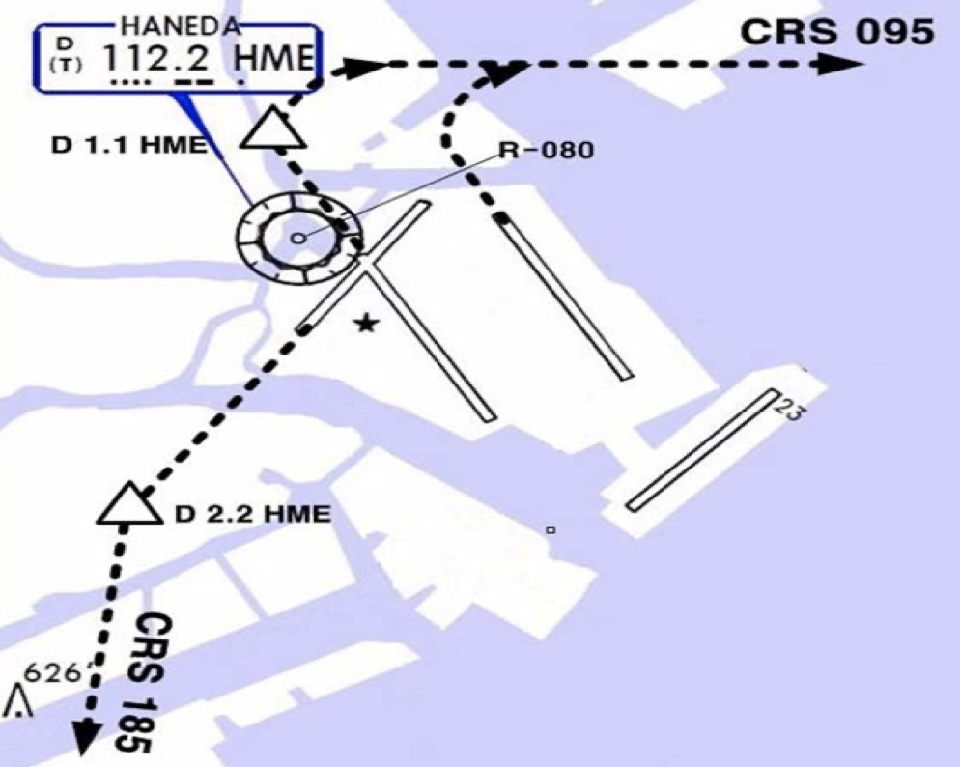
RJTT(HND) 21ft | RKSI(ICN) 23ft
Delta Oper 132.075 DCL -15분 | KE ICN 131.5
HND : SID – NADP 1
ALL | BEKLA x OPPAR x |  | RWY H/D | RWY CRS |  | ATC | RWY H/D
HME 112.2 | 34L 111.7 | 16R 111.55 | 34R 108.9 | 16L 111.95 |  | 22 108.1 | 23 110.5
HUD |  | 34L(18’) 9843’ |  |  | 16R(77’) 8268’
 |  | 34R(21’) 9843’ |  |  | 16L(19’) 9744’
 |  | 22(35’) 8202’ |  |  | 23(55’) 8202’
34L : HME 351/1.1, R095, 34R : HME R080, R095, 22 : HME /2.2 R185
34R BEKLA : KAIJI 230kts, TORAM Flap5 SPD 16L : BEKLA : PLUTO 230kts
DEP 120.8
TKO 120.5 – 132.45 – 133.02 – 133.8
TGU 120.57
APP 119.75
Home
ICN : STAR
ILS 33/34 | GUKDO xE | ENPIL | GUKDO 180
ILS 15/16 | GUKDO xH | MUNAN | GUKDO 180
HUD | 33L/R 34L(23’) | 12303’ | 15L/R 16R(23’)
 | 34R(23’) | 13123’ | 16L(23’)
FIX | RWY /8, /5 , YJU R271
33R : C4(7529’), C5(8513’), 33L : B4(7563’), B5(8513‘) 15L : C2(7522’), C1(8536’), 15R : B3(7454‘), B2(8641‘)
34L : P7(5600’), P8(6578’), 34R : N4(6876’), N5(8507‘) 16R : P6(5597’), P5(6574’), 16L : N3(7043‘), N2(8444‘)
8NM 180kts, 5NM 160kts, Parr TAXI 10kts이상, HIRO

Slide 28
RKSI(ICN) 23ft | RJGG(NGO) 12ft
KE ICN 131.5 DCL -10분 TOBT 5분 차이시 CTC Comm | SWISSPORT OPERATION 132.05
ICN : SID (33/34 NADP 1, 15/16 NADP 2)
33L/R | EGOBA xE/A |  | 333 |  | 333 |  | 5500/ATC |  | 333
34L/R | EGOBA xY |  | 333 |  | 333 |  | ATC |  | 333
15L/R | EGOBA xC |  | 153 |  | 153 |  | 5000 |  | 153
16L/R | EGOBA xH |  | 153 |  | 153 |  | 5000 |  | 153
NCN 113.8 |  | 33L 109.3 |  | 33R 108.9 |  | 15L 111.9 |  | 15R 109.1
WNG 112.9 |  | 34L 109.95 |  | 34R 108.1 |  | 16L 110.35 |  | 16R 108.55
33L/R : NC05L/R, R242 YJU R271 |  |  |  | 34L/R : WNG333/4.6, R242 YJU R271
HUD | 33L/R 34L(23’) |  |  | 12303’ |  | 15L/R 16R(23’)
 | 34R (23’) |  |  | 13123’ |  | 16L (23’)
Parallel TWY 10KTS 이상(R17 MAX 15kts)
DEP 125.15
TGU 134.17 – TKO 133.8 – 133.02
센트레아 APP – 121.05
Home
NGO : STAR (SAMON 290, MARIA 130)
36 | CHESS(CARDS) SOUTH | PROBE | ILS Z 36
18 | CHESS(CARDS) NORTH | QUEST | ILS Z 18
HUD | 36(15’) 11483’ 18(15’)
36 : A6(5213’), A7(6525’), A8(7837’) 18 : A5(5393’), A4(6528’), A3(7841’)
RWY36 : After 1500ft L/D FLAP RWY 18 : After 3000ft L/G DN & L/D FLAP Caution Stop line, Yellow Ramp line, VDGS!!!

Slide 29
RJGG(NGO) 12ft | RKSI(ICN) 23ft
SWISSPORT OPERATION 132.05 DCL -15분 | KE ICN 131.5
NGO : SID – TANGO tx (NADP 1)
36 | OUMI x - TANGO tx |  | 356 | 356 | ATC (7000) | 356
18 |  |  | 176 | 176 | ATC (7000) | 176
CBE 117.8 |  | 18 109.7 |  |  | 36 111.9
HUD | 36(15’) |  | 11483’ |  | 18(15’)
APU Start 30min, Prepare Intersection T/O
DEP 120.0
TKO 133.55 – 133.8 – TGU 120.52
APP – 119.75
Home
ICN : STAR
ILS 33/34 | GUKDO xE | ENPIL | GUKDO 180
ILS 15/16 | GUKDO xH | MUNAN | GUKDO 180
HUD | 33L/R 34L(23’) | 12303’ | 15L/R 16R(23’)
 | 34R(23’) | 13123’ | 16L(23’)
FIX | RWY /8, /5 , YJU R271
33R : C4(7529’), C5(8513’), 33L : B4(7563’), B5(8513‘) 15L : C2(7522’), C1(8536’), 15R : B3(7454‘), B2(8641‘)
34L : P7(5600’), P8(6578’), 34R : N4(6876’), N5(8507‘) 16R : P6(5597’), P5(6574’), 16L : N3(7043‘), N2(8444‘)
8NM 180kts, 5NM 160kts, Parr TAXI 10kts이상, HIRO

Slide 30
RKSS(GMP) 59ft | ZSSS(SHA) 10ft
KE GMP 131.15 DCL -15분 가능 TOBT 5분 차이시 CTC Comm | China Eastern 131.5
Rwy 32R Takeoff
(06:00L~0900L / 12:00L~15:00L /18:00L~21:00L)
GMP : SID (NADP 1)
32L/R | BULTI xT |  | 324 |  | 324 |  | 5000 |  | 324
 | (BULTI xQ) |  | 324 |  | 324 |  | 5000 |  | 324
14L/R | BULTI xU |  | 144 |  | 144 |  | 6000 |  | 144
 | (BULTI xZ) |  | 144 |  | 144 |  | 6000 |  | 144
KIP 113.6 |  | 32L 108.3 | 32R 110.7 |  |  | 14L 109.9 |  | 14R 108.7
32L/R : KIP324/5, R220 YJU R271 |  |  |  | 14L/R : KIP144/4, R220 P73 /2
HUD |  | 32L(41’) |  | 10499’ |  |  | 14R(34’)
 |  | 32R(42’) |  | 11811’ |  |  | 14L(38’)
APRON(130.875) -> GND(121.9) -> TWR (All by ATC)
Home
CJU 124.52
SHA 120.95
SHA APP – 125.625 - 125.4 – 126.65
SHA : STAR SPD Rest From IAF(210kts), 180kts, 160kts
ILS Z 18L | PUD 61A |  | SS204 |  | above 2960ft PUD QRH Below 2960ft SHA QRH
ILS Z 36R | PUD 71A |  | SS405 |  | Below 2960ft SHA QRH
HUD |  | 18L(6’) |  | 10499’ |  | 36R(9’)
18L: A3(6555’), A4(7578’) 36R: A2(5738’), A1(7089’)
Traffic PTN West of RWY, Landing East RWY Normally Des 550m (1800ft) L08, L09 not available B737 Shall CTC Apron Before Entering

Slide 31
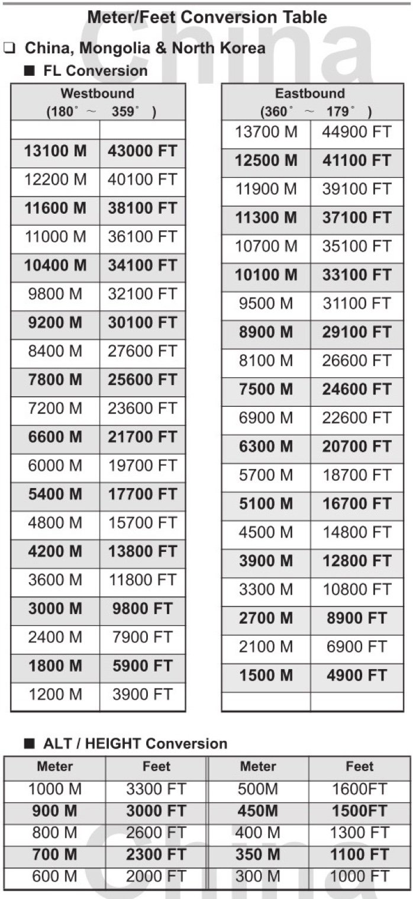
TL
TA
550M 1800ft
Home

Slide 32
ZSSS(SHA) 10ft | RKSS(GMP) 59ft
China Eastern 131.5 DCL -20분, READ BACK! | KE GMP 131.15
Rwy 32L Landing
(06:00L~0900L / 12:00L~15:00L /18:00L~21:00L)
SHA : SID (NADP 1) N DEP Freq : 126.65 South DEP : 121.10 (without ATC)
18R | LAMEN 61D |  |  | 183 |  | 183 | 3000 (900m) | 3000 900m | 183
36L | LAMEN 73D |  |  | 003 |  | 003 | 3000 (900m) | 3000 900m | 003
 | LAMEN 71D |  |  | 003 |  | 003 | 3000 or 4900 | 3000 4900 | 003
SHA 117.2 |  |  | 18L 111.3 |  |  |  | 36R 110.3
HUD |  | 18R (9’) |  |  | 10827’ |  |  | 36L (76’)
RWY 36L LAMEN 71D : L/H Turn Below 200m(660ft) in DCL
DEP 121.1
SHA APP 125.4 – 125.625 – SHA 120.95
ICN 125.725 – 124.52
APP – 119.75
Home
GMP : STAR
ILS 32L/R | OLMEN xT |  |  | BUMSI | OLMEN 160
ILS 14R | OLMEN xU |  |  | DOKDO | OLMEN 160
HUD |  |  | 32L(41’) | 10499’ | 14R(34’)
 |  |  | 32R(42’) | 11811’ | 14L(38’)
FIX |  | KIP /8(RWY 32), YJU R271, P73 /2
32L : D3(6532’), E2(9117’), 32R : E1(6614’) 14R : C1(6578’)
32L/R : 8 KIP L/G, 14R : LOC CAPT L/G FAF : Final Flap TWR -> GND -> APRON (All by ATC) Except RWY14R Landing (Until R)

Slide 33
RKSS(GMP) 59ft | RJBB(KIX) 17ft
KE GMP 131.15 DCL -15분 가능 TOBT 5분 차이시 CTC Comm | KE KIX 130.95
Rwy 32R Takeoff
(06:00L~0900L / 12:00L~15:00L /18:00L~21:00L)
GMP : SID (NADP 1)
32L/R | EGOBA xT |  | 324 |  | 324 |  | 5000 |  | 324
 | (EGOBA xQ) |  | 324 |  | 324 |  | 5000 |  | 324
14L/R | EGOBA xU |  | 144 |  | 144 |  | 6000 |  | 144
KIP 113.6 |  | 32L 108.3 | 32R 110.7 |  |  | 14L 109.9 |  | 14R 108.7
32L/R : KIP324/5, R220 YJU R271 |  |  |  | 14L/R : KIP144/4, R220 P73 /2
HUD |  | 32L(41’) |  | 10499’ |  |  | 14R(34’)
 |  | 32R(42’) |  | 11811’ |  |  | 14L(38’)
APRON(130.875) -> GND(121.9) -> TWR (All by ATC)
DEP 125.15 – TGU 134.17 - TKO 133.8
KIX RDR 120.85
KIX APP 120.25
Home
KIX : STAR (SAEKI 170, RANDY 150)
06L | ALISA B | BERRY | ILS Y 06L
06R | ALISA A | ALLAN | ILS Y 06R
24L/R | ALISA C | MAYAH | ILS Z 24L/R
HUD | 06L(15’) 13123’ 24R(23’)
 | 06R(5’) 11483’ 24L(12’)
06L : B8(5160’), B6(6751’), 24R : B7(5318’), B9(6751’) 06R : A7(5137’), A6(6938’), 24L : A8(5269’), A9(6976’)
RWY06 : After 2500ft L/G DN, After 1500ft L/D FLAP TAXI RTE 1, 2

Slide 34
RJBB(KIX) 17ft | RKSS(GMP) 59ft
KE KIX 130.95 DCL -15분 | KE GMP 131.15
Rwy 32L Landing
(06:00L~0900L / 12:00L~15:00L /18:00L~21:00L)
KIX : SID – SOUJA tx (NADP 1)
06L/R | HELEN x - SOUJA tx |  | 058 |  | 058 | ATC (9000) |  | 058
24L/R |  |  | 238 |  | 238 | ATC (9000) |  | 238
KIE 111.6 |  | 06L 108.7 |  | 06R 108.1 |  | 24L 110.7 | 24R 108.5
HUD | 06L(15’) |  | 13123’ |  |  | 24R(23’)
 | 06R (5’) |  | 13123’ |  |  | 24L (12’)
APU Start, TAXI RTE 1, 2
DEP 119.2
TKO 132.7 – 133.8
TGU 120.57
APP 119.75
Home
GMP : STAR
ILS 32L/R | GUKDO xT |  |  | BUMSI | OLMEN 160
ILS 14R | GUKDO xU |  |  | DOKDO | OLMEN 160
HUD |  |  | 32L(41’) | 10499’ | 14R(34’)
 |  |  | 32R(42’) | 11811’ | 14L(38’)
FIX |  | KIP /8(RWY 32), YJU R271, P73 /2
32L : D3(6532’), E2(9117’), 32R : E1(6614’) 14R : C1(6578’)
32L/R : 8 KIP L/G, 14R : LOC CAPT L/G FAF : Final Flap TWR -> GND -> APRON (All by ATC) Except RWY14R Landing (Until R)

Slide 35
RKPC(CJU) 119ft | ZBAA(PEK) 116ft
KE CJU 129.4 DCL -10분 | Air China Beijing 132.0
CJU : SID (NADP 1)
07 | LIMDI xE |  |  | 066 |  | 066 |  | 9000 | 066
25 | KAMIT xW |  |  | 246 |  | 246 |  | ATC | 246
YDM 109.0 |  |  | 07 109.9 |  |  |  | 25 111.3
07 : NONE |  |  |  |  | 25 : YDM246/3, R290
HUD |  | 07(87’) |  |  | 10433’ |  |  | 25(76’)
07 : Passing G4 CTC TWR 25 : 31 Holding PSN on P, E1,2,3 CTC TWR
Home
DEP 121.2 – TGU 124.52 – 120.72 – 126.17 – 132.8
DLC 132.95 - TAO 133.72 – 128.15 – PEK 125.6
PEK APP 120.6 – Final 119.0
PEK : STAR (RW01/19 main (RW36L/18R))
01(36L) | DUMAP xZA | AA421 | ILS Z 01(Y 36L)
19(18R)) | DUMAP xZA | AA521 | ILS Z 19(Y 18R)
HUD | 01(84’) 12467’ 19(94’) 3.2도
 | 36L(107’) 10499’ 18R(115’)
FIX : RWxx /8(180kts), /6(160kts) TMA Max 280kts
01 : Q5(5223’), Q6(7024’), 19 :Q4(5298’), Q3(7103’) 36L : P6(6276’), P7(7719’), 18R : P3(6223’), P2(7552’)
APU off Procedure (GND Air Cond’ & GPU) Standard TAXI RTE in Jeppesen Chart

Slide 36
TL
TA
550M 1800ft
Home

Slide 37
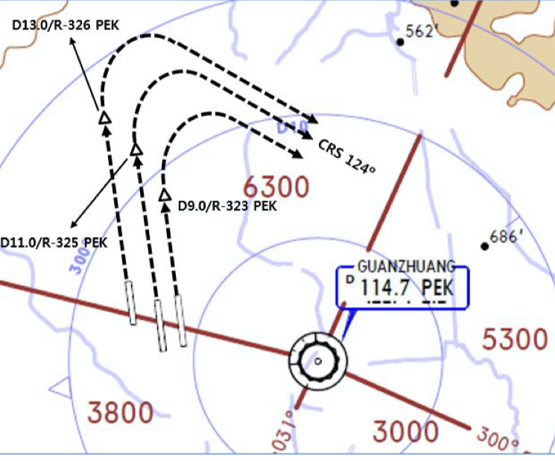
ZBAA(PEK) 116ft | RKPC(CJU) 119ft
Air China Beijing 132.0 DCL 30분전, Voice 10분전 (COBT/STD 15분 차이 CTC Comm) | KE CJU 129.4
PEK : SID (NADP 1) RW36R/18L Intersec T/O W2, W7
36R (01) | MUGLO xWD(xYD) |  |  | 359 |  |  | 359 | ATIS/DCL | 3000 900m | 359
18L (19) | MUGLO xZD(xYD) |  |  | 179 |  |  | 179 | ATIS/DCL | 3000 900m | 179
PEK 114.7 |  |  | 36R 111.55 |  | 18L 109.3 |  |  | 01 108.5 |  | 19 108.9
36R : PEK 325/11, 36L : PEK 326/13, 01 : PEK 323/9 R124
HUD |  | 36R(98’) 01(84’) |  |  |  | 12467’ |  |  | 18L(110’) 19(94’)
COBT from ATIS “Enroute”, Bad Wx DOTRA SID
DEP 124.4
PEK APP 120.6 – PEK 125.6
DLC 123.2 – 132.95
ICN 132.8 – 126.17 – 120.72
124.52 - APP 119.75
Home
CJU : STAR AFT Merge PT(220kts) DCT IAF(210kts), FAF (160kts)
ILS Z 07 | LIMDI xP |  | YUMIN
ILS Z 25 | LIMDI xT |  | DUKAL
HUD |  | 07(87’) |  | 10433’ |  | 25(76’)
07 : P6(5176’), P5(5882’), P4(6840’-ATC HIRO) 25 : P7(5219’), P8(5882’), P10(7524’-ATC HIRO)
Entering Rapid TWY CTC GND 121.675 (STOP x) HST 40KTS

Slide 38
RKSI(ICN) 23ft | ZSNJ(NKG) 49ft
KE ICN 131.5 DCL -10분 TOBT 5분 차이시 CTC Comm | None
ICN : SID (33/34 NADP 1, 15/16 NADP 2)
33L/R | BOPTA xA |  | 333 |  | 333 |  | ATC |  | 333
34L/R | BOPTA xY |  | 333 |  | 333 |  | ATC |  | 333
15L/R | BOPTA xC |  | 153 |  | 153 |  | 5000 |  | 153
16L/R | BOPTA xH |  | 153 |  | 153 |  | 5000 |  | 153
NCN 113.8 |  | 33L 109.3 |  | 33R 108.9 |  | 15L 111.9 |  | 15R 109.1
WNG 112.9 |  | 34L 109.95 |  | 34R 108.1 |  | 16L 110.35 |  | 16R 108.55
33L/R : NC05L/R, R242 YJU R271 |  |  |  | 34L/R : WNG333/4.6, R242 YJU R271
HUD | 33L/R 34L(23’) |  |  | 12303’ |  | 15L/R 16R(23’)
 | 34R (23’) |  |  | 13123’ |  | 16L (23’)
Parallel TWY 10KTS 이상(R17 MAX 15kts)
DEP 125.15 – TGU 126.17 – 120.72 – 124.52(125.72)
SHA 120.95 – 120.55 – 125.95 – 119.075
NKG APP 126.55 – 119.25
Home
NKG : STAR (‘D’ N31 34.0 E118 42.1 – R101, R289)
07 (06) | ESB 71F/21A (ESB 61F/11A) | SNQ | ILS Z 07 (ILS Z 06)
25 (24) | ESB 52F/22A (ESB 42F/12A) | NJ210 | ILS Z 25 (ILS Z 24)
HUD | 07(41’) 11811’ 25(39’)
 | 06(43’) 11811’ 24(38’)
07 : D5(6499’), D6(7582’), 25 : D2(6505’), D1(7582’) 06 : A5(6614’), A6(7860’), 24 : A3(6637’), A9(7864’)
IAF, Missed App SPD APP : 210kts or 205kts Follow Me Car on C 13, APU off Procedure

Slide 39
TL
TA
550M 1800ft
Home

Slide 40
ZSNJ(NKG) 49ft | RKSI(ICN) 23ft
None DCL 가능, READ BACK! | KE ICN 131.5
NKG : SID (NADP 1) (ATC Hold Expected Fuel Add!!)
06 (07) | ESB 61X/11D (ESB 71X/21D) |  |  | 064 |  |  | 064 | 3000 (900m) | 3000 900m | 064
24 (25) | ESB 42X/12D (ESB 52X/22D) |  |  | 244 |  |  | 244 | 3000 (900m) | 3000 900m | 244
NJL 113.6 |  |  | 07 108.7 |  | 25 111.3 |  |  | 06 110.3 |  | 24 110.9
HUD |  | 06(43’) 07(41’) |  |  |  | 11811’ |  |  | 24(38’) 25(39’)
APU Start, TUG Connect After Beacon L/T ON
DEP 119.25
NKG APP 126.55
SHA 119.075 – 125.95 - 120.55 - 120.95
ICN 125.725(124.52) – 120.72 – 126.17
APP – 119.75
Home
ICN : STAR
ILS 33/34 | OLMEN xE | ENPIL | OLMEN 180
ILS 15/16 | OLMEN xH | MUNAN | OLMEN 180
HUD | 33L/R 34L(23’) | 12303’ | 15L/R 16R(23’)
 | 34R(23’) | 13123’ | 16L(23’)
FIX | RWY /8, /5 , YJU R271
33R : C4(7529’), C5(8513’), 33L : B4(7563’), B5(8513‘) 15L : C2(7522’), C1(8536’), 15R : B3(7454‘), B2(8641‘)
34L : P7(5600’), P8(6578’), 34R : N4(6876’), N5(8507‘) 16R : P6(5597’), P5(6574’), 16L : N3(7043‘), N2(8444‘)
8NM 180kts, 5NM 160kts, Parr TAXI 10kts이상, HIRO

Slide 41
RKSI(ICN) 23ft | ZSQD(TAO) 30ft
KE ICN 131.5 DCL -10분 TOBT 5분 차이시 CTC Comm | None
ICN : SID (33/34 NADP 1, 15/16 NADP 2)
33L/R | NOPIK xA |  | 333 |  | 333 |  | ATC |  | 333
34L/R | NOPIK xY |  | 333 |  | 333 |  | ATC |  | 333
15L/R | BINIL xC |  | 153 |  | 153 |  | 5000 |  | 153
16L/R | BINIL xH |  | 153 |  | 153 |  | 5000 |  | 153
NCN 113.8 |  | 33L 109.3 |  | 33R 108.9 |  | 15L 111.9 |  | 15R 109.1
WNG 112.9 |  | 34L 109.95 |  | 34R 108.1 |  | 16L 110.35 |  | 16R 108.55
33L/R : NC05L/R, R242 P518 R068, R278 |  |  |  | 34L/R : WNG333/4.6, R242 P518 R068, R278
HUD | 33L/R 34L(23’) |  |  | 12303’ |  | 15L/R 16R(23’)
 | 34R (23’) |  |  | 13123’ |  | 16L (23’)
Parallel TWY 10KTS 이상(R17 MAX 15kts)
DEP 125.15 – TGU 132.8 – DLC 132.95
TAO 134.85 – 133.72 – 134.85
TAO APP 124.6 – 119.4
Home
TAO : STAR (AVBIK R014 - LAROP R159 동쪽 금지)
35(34) | LAT 91A/01A | JD405 | ILS Z 35(34)
17(16) | LAT 81A/11A | JD305 | ILS Z 17(16)
HUD | 35(27’) 11811’ 17(29’)
 | 34(27’) 11811’ 16(27’)
FIX : AVBIK R014, LAROP R159 (두점 연결)
35 : S2(5255’), S4(6624’), 17 : S1(5282’), S3(6604’) 34 : R2(5278’), R4(6650’), 16 : R1(5318’), R3(6706’)
위 Vacate Point 불가시 TWR 보고 Follow Me Car on Lxx, APU off Procedure

Slide 42
TL
TA
550M 1800ft
Home

Slide 43
ZSQD(TAO) 30ft | RKSI(ICN) 23ft
None DCL 가능, READ BACK! (Voice 10분전 부터) | KE ICN 131.5
TAO : SID (NADP 1)
34 (35) | LAT 91D/01D |  |  | 350 |  |  | 350 | ATC 3000 (900m) | 3000 900m | 350
16 (17) | LAT 81D/11D |  |  | 170 |  |  | 170 | ATC 3000 (900m) | 3000 900m | 170
JDG 114.45 |  |  | 17 110.15 |  | 35 109.75 |  |  | 16 111.9 |  | 34 108.55
HUD |  | 34(27’) 35(27’) |  |  |  | 11811’ |  |  | 16(27’) 17(29’)
Heading 190, Join W209 -> DCT LATUX CRS 147
APP 119.4
TAO APP 124.6
TAO 134.85 – 133.72 – DLC 132.95
ICN 132.8 – APP 119.75
Home
ICN : STAR
ILS 33/34 | REBIT xA | PAMBI | REBIT 170
ILS 15/16 | REBIT xH | MUNAN | REBIT 170
HUD | 33L/R 34L(23’) | 12303’ | 15L/R 16R(23’)
 | 34R(23’) | 13123’ | 16L(23’)
FIX | RWY /8, /5 , P518 R068, R278
33R : C4(7529’), C5(8513’), 33L : B4(7563’), B5(8513‘) 15L : C2(7522’), C1(8536’), 15R : B3(7454‘), B2(8641‘)
34L : P7(5600’), P8(6578’), 34R : N4(6876’), N5(8507‘) 16R : P6(5597’), P5(6574’), 16L : N3(7043‘), N2(8444‘)
8NM 180kts, 5NM 160kts, Parr TAXI 10kts이상, HIRO

Slide 44
RKSI(ICN) 23ft | ZBAA(PEK) 116ft
KE ICN 131.5 DCL -10분 TOBT 5분 차이시 CTC Comm | Air China Beijing 132.0
ICN : SID (33/34 NADP 1, 15/16 NADP 2)
33L/R | NOPIK xA |  | 333 |  | 333 |  | ATC |  | 333
34L/R | NOPIK xY |  | 333 |  | 333 |  | ATC |  | 333
15L/R | BINIL xC |  | 153 |  | 153 |  | 5000 |  | 153
16L/R | BINIL xH |  | 153 |  | 153 |  | 5000 |  | 153
NCN 113.8 |  | 33L 109.3 |  | 33R 108.9 |  | 15L 111.9 |  | 15R 109.1
WNG 112.9 |  | 34L 109.95 |  | 34R 108.1 |  | 16L 110.35 |  | 16R 108.55
33L/R : NC05L/R, R242 P518 R068, R278 |  |  |  | 34L/R : WNG333/4.6, R242 P518 R068, R278
HUD | 33L/R 34L(23’) |  |  | 12303’ |  | 15L/R 16R(23’)
 | 34R (23’) |  |  | 13123’ |  | 16L (23’)
Parallel TWY 10KTS 이상(R17 MAX 15kts)
DEP 125.15 – TGU 132.8 – DLC 132.95
TAO 133.72 – 128.15 – PEK 125.6
PEK APP 120.6 – Final 119.0
Home
PEK : STAR (RW01/19 main (RW36L/18R))
01(36L) | DUMAP xZA | AA421 | ILS Z 01(Y 36L)
19(18R)) | DUMAP xZA | AA521 | ILS Z 19(Y 18R)
HUD | 01(84’) 12467’ 19(94’) 3.2도
 | 36L(107’) 10499’ 18R(115’)
FIX : RWxx /8(180kts), /6(160kts) TMA Max 280kts
01 : Q5(5223’), Q6(7024’), 19 :Q4(5298’), Q3(7103’) 36L : P6(6276’), P7(7719’), 18R : P3(6223’), P2(7552’)
APU off Procedure (GND Air Cond’ & GPU) Standard TAXI RTE in Jeppesen Chart

Slide 45
TL
TA
550M 1800ft
Home

Slide 46
ZBAA(PEK) 116ft | RKSI(ICN) 23ft
Air China Beijing 132.0 DCL 30분전, Voice 10분전 (COBT/STD 15분 차이 CTC Comm) | KE ICN 131.5
PEK : SID (NADP 1) RW36R/18L Intersec T/O W2, W7
36R (01) | MUGLO xWD(xYD) |  |  | 359 |  |  | 359 | ATIS/DCL | 3000 900m | 359
18L (19) | MUGLO xZD(xYD) |  |  | 179 |  |  | 179 | ATIS/DCL | 3000 900m | 179
PEK 114.7 |  |  | 36R 111.55 |  | 18L 109.3 |  |  | 01 108.5 |  | 19 108.9
36R : PEK 325/11, 36L : PEK 326/13, 01 : PEK 323/9 R124
HUD |  | 36R(98’) 01(84’) |  |  |  | 12467’ |  |  | 18L(110’) 19(94’)
COBT from ATIS “Enroute”, Bad Wx DOTRA SID
DEP 124.4
PEK APP 120.6 – PEK 125.6
DLC 123.2 – 132.95
ICN 132.8 – APP 119.75
Home
ICN : STAR
ILS 33/34 | REBIT xA | PAMBI | REBIT 170
ILS 15/16 | REBIT xH | MUNAN | REBIT 170
HUD | 33L/R 34L(23’) | 12303’ | 15L/R 16R(23’)
 | 34R(23’) | 13123’ | 16L(23’)
FIX | RWY /8, /5 , P518 R068, R278
33R : C4(7529’), C5(8513’), 33L : B4(7563’), B5(8513‘) 15L : C2(7522’), C1(8536’), 15R : B3(7454‘), B2(8641‘)
34L : P7(5600’), P8(6578’), 34R : N4(6876’), N5(8507‘) 16R : P6(5597’), P5(6574’), 16L : N3(7043‘), N2(8444‘)
8NM 180kts, 5NM 160kts, Parr TAXI 10kts이상, HIRO

Slide 47
RKSI(ICN) 23ft | ZYTX(SHE) 198ft
KE ICN 131.5 DCL -10분 TOBT 5분 차이시 CTC Comm | China Southern Dispatch 131.5
ICN : SID (33/34 NADP 1, 15/16 NADP 2)
33L/R | NOPIK xA |  | 333 |  | 333 |  | ATC |  | 333
34L/R | NOPIK xY |  | 333 |  | 333 |  | ATC |  | 333
15L/R | BINIL xC |  | 153 |  | 153 |  | 5000 |  | 153
16L/R | BINIL xH |  | 153 |  | 153 |  | 5000 |  | 153
NCN 113.8 |  | 33L 109.3 |  | 33R 108.9 |  | 15L 111.9 |  | 15R 109.1
WNG 112.9 |  | 34L 109.95 |  | 34R 108.1 |  | 16L 110.35 |  | 16R 108.55
33L/R : NC05L/R, R242 P518 R068, R278 |  |  |  | 34L/R : WNG333/4.6, R242 P518 R068, R278
HUD | 33L/R 34L(23’) |  |  | 12303’ |  | 15L/R 16R(23’)
 | 34R (23’) |  |  | 13123’ |  | 16L (23’)
Parallel TWY 10KTS 이상(R17 MAX 15kts)
DEP 125.15 – TGU 132.8 – DLC 132.95 – 135.65
DLC 134.325(128.775)
SHE APP 125.55 – 119.825
TWR 118.1
Home
SHE : STAR (CLR Limit TOSID Late Handoff to SHE)
06 | TOSID 62A, 61A | TX504 | ILS Z 06
24 | TOSID 72A, 11A | TX662 | ILS Z 24
HUD | 06(170’) 10499’ 24(198’)
Around TOSID – Present TRK or HDG – CTC SHE CTL
06 : D(6210’), C(7854’), 24 : J(6227’), K(7864’) - ATC
06 : HP06(03), 24 : HP06(03) Follow Me Car Confirm Chocks in Place then Parking Brake Release!! APU off Procedure (GND Air Cond’ & GPU)

Slide 48
TL
TA
550M 1800ft
Home

Slide 49
ZYTX(SHE) 198ft | RKSI(ICN) 23ft
China Southern Dispatch 131.5 DCL 가능, 5분전 READ BACK! (Voice 10분전) | KE ICN 131.5
SHE : SID (NADP 1) A2, A8 Intersec T/O by ATC
06 | TOSID 61,62D |  |  | 056 |  | 056 | ATC/DCL | 3000 900m | 056
24 | TOSID 71,72D |  |  | 236 |  | 236 | ATIS/DCL | 3000 900m | 236
SEY 114.1 |  |  | 06 110.5 |  |  |  | 24 110.3 |  | 19 108.9
HUD |  | 06(170’) |  |  | 10499’ |  |  | 24(198’)
Follow FollowMe Car Until HPxx Be Careful “Hold short CAT I Hold line” Maintain Present TRK/HDG Join A588(CRS 217) Offset R3 → Active Fix DCT and EXE again!!
CTC APP without TWR Instruction
APP 119.825 – 125.55
DLC 134.325 – 135.65
DLC 132.95
ICN 132.8 – APP 119.75
Home
ICN : STAR
ILS 33/34 | REBIT xA | PAMBI | REBIT 170
ILS 15/16 | REBIT xH | MUNAN | REBIT 170
HUD | 33L/R 34L(23’) | 12303’ | 15L/R 16R(23’)
 | 34R(23’) | 13123’ | 16L(23’)
FIX | RWY /8, /5 , P518 R068, R278
33R : C4(7529’), C5(8513’), 33L : B4(7563’), B5(8513‘) 15L : C2(7522’), C1(8536’), 15R : B3(7454‘), B2(8641‘)
34L : P7(5600’), P8(6578’), 34R : N4(6876’), N5(8507‘) 16R : P6(5597’), P5(6574’), 16L : N3(7043‘), N2(8444‘)
8NM 180kts, 5NM 160kts, Parr TAXI 10kts이상, HIRO

Slide 50
RKSI(ICN) 23ft | ZSPD(PVG) 13ft
KE ICN 131.5 DCL -10분 TOBT 5분 차이시 CTC Comm | China Eastern 130.5
ICN : SID (33/34 NADP 1, 15/16 NADP 2)
33L/R | BOPTA xA |  | 333 |  | 333 |  | ATC |  | 333
34L/R | BOPTA xY |  | 333 |  | 333 |  | ATC |  | 333
15L/R | BOPTA xC |  | 153 |  | 153 |  | 5000 |  | 153
16L/R | BOPTA xH |  | 153 |  | 153 |  | 5000 |  | 153
NCN 113.8 |  | 33L 109.3 |  | 33R 108.9 |  | 15L 111.9 |  | 15R 109.1
WNG 112.9 |  | 34L 109.95 |  | 34R 108.1 |  | 16L 110.35 |  | 16R 108.55
33L/R : NC05L/R, R242 YJU R271 |  |  |  | 34L/R : WNG333/4.6, R242 YJU R271
HUD | 33L/R 34L(23’) |  |  | 12303’ |  | 15L/R 16R(23’)
 | 34R (23’) |  |  | 13123’ |  | 16L (23’)
Parallel TWY 10KTS 이상(R17 MAX 15kts)
DEP 125.15 – TGU 126.17 – 120.72 – 124.52(125.72)
SHA 120.95
SHA APP 125.62(119.975) – 125.4
Home
PVG : STAR (North of ‘PVGNB’, R-276 Prohibited)
34R(L)/35L(R) | DUM 91A/92A | MP2 | ILS Z xx
16L(R)/17R(L) | DUM 81A/82A | MP1 | ILS Z xx
HUD | 34R/L(11’/12’) 12467’ 16L/R(12’/11’)
 | 35R(10’) 13123’ 17L10’)
 | 35L(12’) 11155’ 17R(12’)
34R : G4(5603’), G5(6896’), 16L : G3(5577’), G2(6909’) 35L : D4(5636’), D5(6932’), 17R : D3(5626’), D2(6942’)
Normally DUMET 6000m Follow Me Car Insight – TAXI L/T off,APU off Procedure

Slide 51
TL
TA
550M 1800ft
Home

Slide 52
ZSPD(PVG) 13ft | RKSI(ICN) 23ft
China Eastern 130.5 DCL 20분전, No READ BACK! | KE ICN 131.5
PVG : SID (NADP 1) (ATC Hold Expected Fuel Add!!)
34L/R 35R/L | LAM 92D (LAM 91D) |  |  | 348 |  |  | 348 | ATC (900m) | 348
16R/L 17L/R | LAM 82D (LAM 81D) |  |  | 168 |  |  | 168 | ATC (900m) | 168
PUD 116.9 |  |  | 34R 108.9 |  | 35L 108.1 |  |  | 34L 108.3 | 35R 111.9
 |  |  | 16L 111.5 |  | 17R 111.1 |  |  | 16R 108.7 | 17L 110.7
HUD |  | 34R/L(11’/12’) 35R(10’) 35L(12’) |  |  |  | 12467’ 13123’ 11155’ |  | 16L/R(12’/11’) 17L(10’) 17R(12’)
APU Start, TUG Connect After Beacon L/T ON Ready for Intersection T/O
SHA APP 125.4 (Without Instruction)
SHA APP 125.62(119.975)
SHA 120.95
ICN 125.725(124.52) – 120.72 – 126.17
APP – 119.75
Home
ICN : STAR
ILS 33/34 | OLMEN xE | ENPIL | OLMEN 180
ILS 15/16 | OLMEN xH | MUNAN | OLMEN 180
HUD | 33L/R 34L(23’) | 12303’ | 15L/R 16R(23’)
 | 34R(23’) | 13123’ | 16L(23’)
FIX | RWY /8, /5 , YJU R271
33R : C4(7529’), C5(8513’), 33L : B4(7563’), B5(8513‘) 15L : C2(7522’), C1(8536’), 15R : B3(7454‘), B2(8641‘)
34L : P7(5600’), P8(6578’), 34R : N4(6876’), N5(8507‘) 16R : P6(5597’), P5(6574’), 16L : N3(7043‘), N2(8444‘)
8NM 180kts, 5NM 160kts, Parr TAXI 10kts이상, HIRO

Slide 53
RKSI(ICN) 23ft | ZYYJ(YNJ) 624ft
KE ICN 131.5 DCL -10분 TOBT 5분 차이시 CTC Comm | None
ICN : SID (33/34 NADP 1, 15/16 NADP 2)
33L/R | NOPIK xA |  | 333 |  | 333 |  | ATC |  | 333
34L/R | NOPIK xY |  | 333 |  | 333 |  | ATC |  | 333
15L/R | BINIL xC |  | 153 |  | 153 |  | 5000 |  | 153
16L/R | BINIL xH |  | 153 |  | 153 |  | 5000 |  | 153
NCN 113.8 |  | 33L 109.3 |  | 33R 108.9 |  | 15L 111.9 |  | 15R 109.1
WNG 112.9 |  | 34L 109.95 |  | 34R 108.1 |  | 16L 110.35 |  | 16R 108.55
33L/R : NC05L/R, R242 P518 R068, R278 |  |  |  | 34L/R : WNG333/4.6, R242 P518 R068, R278
HUD | 33L/R 34L(23’) |  |  | 12303’ |  | 15L/R 16R(23’)
 | 34R (23’) |  |  | 13123’ |  | 16L (23’)
Parallel TWY 10KTS 이상(R17 MAX 15kts)
DEP 125.15 – TGU 132.8 – DLC 132.95 – 135.65
128.77 – SHE 119.3 – 118.9
YNJ TWR 118.75
Home
YNJ : RNP STAR (RW09 main for L/D) CHK NAV DATA for Holding Area(Expect Hold Mil Train)
09 | KANVU 09A (OMBAD 09A) | YJ504 Report | ILS Z 09
27 | KANVU 19(18,17)A (OMBAD 19(18)A) | YJ604 Report | ILS Z 27
HUD | 09(621’) 8530’ 27(597’) 3.3도
FIX : DPRKK(N43 01.6/E129 52.0) R100, R200 RWY27 /12 (Do not overshoot 12DME ARC)
09 : 180 BACK(8530’), 27 : B(7400’), A (8350’)
Expect Hold Due to Military Training Time(ADD FUEL) PAX Window must closed Between APP and DEP.

Slide 54
TL
TA
550M 1800ft
QFE Next Page
Home

Slide 55
YNJ Altitude / Height Conversion Table
xxxx meters on STD 이후 적용 xxxx meters on QFE xxxx -> REQ QNH -> QNH xxx SET후 Conversion Table 사용 YNJ A/P Elevation : 623ft = 22.5hPa
Height based on QFE (instructed by ATC) | Altitude base on QNH (Set Altitude : QFE + Elev SET)
xxx m on QFE | xxx m plus Elevation Set
3000 m | 10500 ft
2700 m | 9500 ft
2400 m | 8500 ft
2100 m | 7500 ft
1800 m | 6500 ft
1500 m | 5600 ft
1200 m | 4600 ft
1100 m | 4200 ft
1000 m | 3900 ft
850 m | 3400 ft
800 m | 3200 ft
750 m | 3100 ft
550 m | 2400 ft
515 m | 2300 ft
500 m | 2300 ft
425 m | 2000 ft
355 m | 1800 ft
200 m | 1300 ft
100 m | 1000 ft
0 m | 623 ft

Slide 56
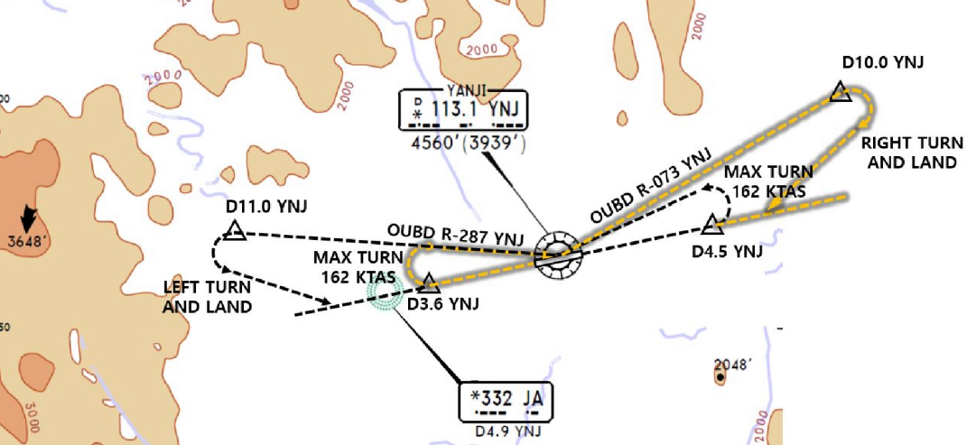
ZYYJ(YNJ) 624ft | RKSI(ICN) 23ft
None TWR 118.75 By Voice | KE ICN 131.5
YNJ : RNP SID (NADP 1) RW27 Main CTOT from GND Staff due to Mil Train Consider Improve C/B & NO Bleed T/O (in Summer)
27 | KANVU 09D (01D) |  |  | 271 |  | 271 | ATC | 3000 900m | 271
09 | KANVU 19D (11D) |  |  | 179 |  | 179 | ATC SPD 200kts | 3000 900m | 179
YNJ 113.1 |  |  | 09 108.7 |  |  |  | 27 109.3 |  | 19 108.9
FIX |  | 27 : YNJ 271/3.6, YNJ 073/10 (MAX 162kts) 09 : YNJ 091/4.5, YNJ 287/11 (MAX 162kts)
HUD |  | 27(597’) 3.3도 |  |  | 8530’ |  |  | 09(621’)
RWY 27 180 Back(Clockwise)
YNJ 118.75
SHE 132.35 – 119.3
DLC 128.77 – 135.65
132.95 - ICN 132.8
Home
ICN : STAR
ILS 33/34 | REBIT xA | PAMBI | REBIT 170
ILS 15/16 | REBIT xH | MUNAN | REBIT 170
HUD | 33L/R 34L(23’) | 12303’ | 15L/R 16R(23’)
 | 34R(23’) | 13123’ | 16L(23’)
FIX | RWY /8, /5 , P518 R068, R278
33R : C4(7529’), C5(8513’), 33L : B4(7563’), B5(8513‘) 15L : C2(7522’), C1(8536’), 15R : B3(7454‘), B2(8641‘)
34L : P7(5600’), P8(6578’), 34R : N4(6876’), N5(8507‘) 16R : P6(5597’), P5(6574’), 16L : N3(7043‘), N2(8444‘)
8NM 180kts, 5NM 160kts, Parr TAXI 10kts이상, HIRO

Slide 57
RKSI(ICN) 23ft | ZSHC(HGH) 22ft
KE ICN 131.5 DCL -10분 TOBT 5분 차이시 CTC Comm | Hangzhou Reporting Office 130.65
ICN : SID (33/34 NADP 1, 15/16 NADP 2)
33L/R | BOPTA xA |  | 333 |  | 333 |  | ATC |  | 333
34L/R | BOPTA xY |  | 333 |  | 333 |  | ATC |  | 333
15L/R | BOPTA xC |  | 153 |  | 153 |  | 5000 |  | 153
16L/R | BOPTA xH |  | 153 |  | 153 |  | 5000 |  | 153
NCN 113.8 |  | 33L 109.3 |  | 33R 108.9 |  | 15L 111.9 |  | 15R 109.1
WNG 112.9 |  | 34L 109.95 |  | 34R 108.1 |  | 16L 110.35 |  | 16R 108.55
33L/R : NC05L/R, R242 YJU R271 |  |  |  | 34L/R : WNG333/4.6, R242 YJU R271
HUD | 33L/R 34L(23’) |  |  | 12303’ |  | 15L/R 16R(23’)
 | 34R (23’) |  |  | 13123’ |  | 16L (23’)
Parallel TWY 10KTS 이상(R17 MAX 15kts)
DEP 125.15 – TGU 126.17 – 120.72 – 124.52(125.72)
SHA 120.95 – 120.55 - SHA APP 125.62 – 119.7
HGH APP 119.82 – 120.4 – 125.55
Home
HGH : STAR - STAR, APP, Missed APP Keep Track Cauton Military Traffic (Missed APP ALT In ATIS)
06/07 | OKT, SUP 91A | HC410 | ILS Z xx
24/25 | OKT, SUP 81A | HC305 | ILS Z xx
HUD | 06(22’) 11155’ 24(22’)
 | 07(22’) 11811’ 25(22’)
06 : C5(5613’), C6(6899’), 24 : C4(5613’), C3(6981’) 07 : A5(6266’), A6(7565’), 25 : A4(6250’), A3(7555’) TWR Permisson
TAXI RTE In Jeppesen Chart Follow Me Car On B4 ro K, APU off Procedure

Slide 58
TL
TA
550M 1800ft
Home

Slide 59
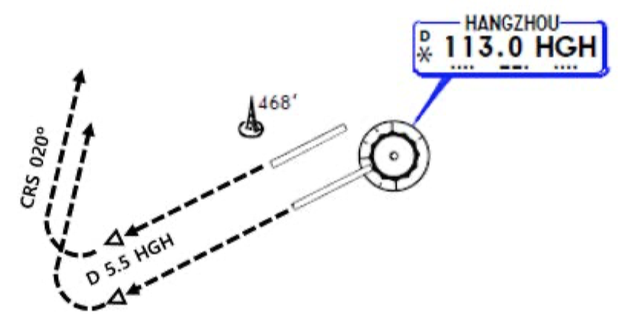
ZSHC(HGH) 22ft | RKSI(ICN) 23ft
Hangzhou Reporting Office 130.65 DCL(NO Readback) Voice 10min전 | KE ICN 131.5
HGH: SID (NADP 1)
06/07 | OKT, SUP 91D |  |  | 069 |  | 069 | 3000m (900m) | 069
24/25 | SUP 81D |  |  | 249 |  | 249 | 3000m (900m) | 249
HGH 113.0 |  |  | 06 110.5 |  | 07 110.35 |  | 24 111.5 | 25 108.5
FIX |  | 24/25 : HGH 249/5.5, R020
HUD |  | 06(22’) 11155’ 24(22’) |  |  |  |  | 16L/R(12’/11’) 17L(10’)
 |  | 07(22’) 11811’ 25(22’)
APU Start, TUG Connect After Beacon L/T ON Red/Blue PushBack, Verify RWY & Direction After T/O, Report T/O RWY
HGH APP 120.4 – 119.82
SHA APP 119.975
SHA 120.55 - 120.95
ICN 125.725(124.52) – 120.72 – 126.17
APP – 119.75
Home
ICN : STAR
ILS 33/34 | OLMEN xE | ENPIL | OLMEN 180
ILS 15/16 | OLMEN xH | MUNAN | OLMEN 180
HUD | 33L/R 34L(23’) | 12303’ | 15L/R 16R(23’)
 | 34R(23’) | 13123’ | 16L(23’)
FIX | RWY /8, /5 , YJU R271
33R : C4(7529’), C5(8513’), 33L : B4(7563’), B5(8513‘) 15L : C2(7522’), C1(8536’), 15R : B3(7454‘), B2(8641‘)
34L : P7(5600’), P8(6578’), 34R : N4(6876’), N5(8507‘) 16R : P6(5597’), P5(6574’), 16L : N3(7043‘), N2(8444‘)
8NM 180kts, 5NM 160kts, Parr TAXI 10kts이상, HIRO

Slide 60
RKSI(ICN) 23ft | VVCR(CXR) 46ft
KE ICN 131.5 DCL -10분 TOBT 5분 차이시 CTC Comm | None
ICN : SID (33/34 NADP 1, 15/16 NADP 2)
33L/R | BOPTA xA |  | 333 |  | 333 |  | ATC |  | 333
34L/R | BOPTA xY |  | 333 |  | 333 |  | ATC |  | 333
15L/R | BOPTA xC |  | 153 |  | 153 |  | 5000 |  | 153
16L/R | BOPTA xH |  | 153 |  | 153 |  | 5000 |  | 153
NCN 113.8 |  | 33L 109.3 |  | 33R 108.9 |  | 15L 111.9 |  | 15R 109.1
WNG 112.9 |  | 34L 109.95 |  | 34R 108.1 |  | 16L 110.35 |  | 16R 108.55
33L/R : NC05L/R, R242 YJU R271 |  |  |  | 34L/R : WNG333/4.6, R242 YJU R271
HUD | 33L/R 34L(23’) |  |  | 12303’ |  | 15L/R 16R(23’)
 | 34R (23’) |  |  | 13123’ |  | 16L (23’)
Parallel TWY 10KTS 이상(R17 MAX 15kts)
FUK 127.5 – TPE 125.5 – 127.9 – 129.1 – MNL 119.3
MNL RDO 8942(5655) – HCM 120.7
132.35 – 134.05 – CXR APP 127.9
Home
CXR : STAR (Wx, Using RWY from HoChiMinh CTL) RWY20 Max Tail Wind 15kts, chk condition CAAV STAR, APP not Authorized
20L/R | COTUN, BANKE, HUNTA, NHATA xx | CR xxx | ILS Y 20L RNP 20R
02R/L |  |  | ILS X/Z 02L/R
HUD | 02R(15’) 3.5도 | 10000’ |  | 20L(34’)
 | 02L(20’) 3.5도 | 10010’ |  | 20R(46’)
20L : G3(6735’), G1(9603’), 02R : G5(6528’), G7(9662’) 20R : W4(5971’), W3(7680’),02L : W5(5606’), W6(7345’)
FollowMe Car Service, Sensitie VDGS Caution!!

Slide 61
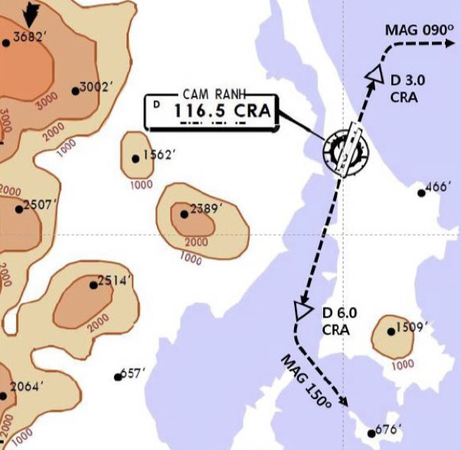
VVCR(CXR) 46ft | RKSI(ICN) 23ft
None TWR 118.2 By Voice | KE ICN 131.5
CNX : RNP SID (NADP 1) Follow Restrictions due to Military Traffic
02L/R | NIHOA xxA |  | 020 |  | 020 | ATC/FL100 | 3000 900m | 020
20R/L | NIHOA xxB |  | 200 |  | 200 | ATC/FL100 | 3000 900m | 200
CRA 116.5 |  | 02R 111.9 |  | 02L 110.7 |  |  | 20L 110.3 | 19 108.9
02 : CRA 020/2, R090 20 : CRA 200/6, R150
HUD | 02L(20’) 3.5도 |  |  | 10010’ |  |  | 20R(46’)
 | 02R(15’) 3.5도 |  |  | 10000’ |  |  | 20L(34’)
TWY Y5 only below wingspan 36m/118ft
DEP 127.9 – HCM 134.05
DAD 123.3 – SNY 122.6
HKG 132.15 – 127.1 – TPE 129.1
125.5 – FUK 127.5
Home
ICN : STAR
ILS 33/34 | OLMEN xE | ENPIL | OLMEN 180
ILS 15/16 | OLMEN xH | MUNAN | OLMEN 180
HUD | 33L/R 34L(23’) | 12303’ | 15L/R 16R(23’)
 | 34R(23’) | 13123’ | 16L(23’)
FIX | RWY /8, /5 , YJU R271
33R : C4(7529’), C5(8513’), 33L : B4(7563’), B5(8513‘) 15L : C2(7522’), C1(8536’), 15R : B3(7454‘), B2(8641‘)
34L : P7(5600’), P8(6578’), 34R : N4(6876’), N5(8507‘) 16R : P6(5597’), P5(6574’), 16L : N3(7043‘), N2(8444‘)
8NM 180kts, 5NM 160kts, Parr TAXI 10kts이상, HIRO

Slide 62
RKSI(ICN) 23ft | VVTS(SGN) 33ft
KE ICN 131.5 DCL -10분 TOBT 5분 차이시 CTC Comm | None
ICN : SID (33/34 NADP 1, 15/16 NADP 2)
33L/R | BOPTA xA |  | 333 |  | 333 |  | ATC |  | 333
34L/R | BOPTA xY |  | 333 |  | 333 |  | ATC |  | 333
15L/R | BOPTA xC |  | 153 |  | 153 |  | 5000 |  | 153
16L/R | BOPTA xH |  | 153 |  | 153 |  | 5000 |  | 153
NCN 113.8 |  | 33L 109.3 |  | 33R 108.9 |  | 15L 111.9 |  | 15R 109.1
WNG 112.9 |  | 34L 109.95 |  | 34R 108.1 |  | 16L 110.35 |  | 16R 108.55
33L/R : NC05L/R, R242 YJU R271 |  |  |  | 34L/R : WNG333/4.6, R242 YJU R271
HUD | 33L/R 34L(23’) |  |  | 12303’ |  | 15L/R 16R(23’)
 | 34R (23’) |  |  | 13123’ |  | 16L (23’)
Parallel TWY 10KTS 이상(R17 MAX 15kts)
FUK 127.5 – TPE 125.5 – 127.9 – 129.1 – MNL 119.3
MNL RDO 8942(5655) – HCM 120.7
132.35 – SGN APP 125.5
Home
SGN : STAR (CPDLC : VVHM) TL 190
25R(L) | DALAP xxH | SOKAN | SOKAN | ILS W 25R/L
07R(L) | DALAP xxG | SAMDU | SAMDU | ILS W 07R, VOR 07L
HUD | 25R(33’) 10007’ 07L(20’) |  | 10007’
 | 25L(32’) 12559’ |  | 10036’ (DISP TH) 07R(24’)
25R:P4(6158’), P5(6991’),07R:S6(4412’),S5(6574’,110도) B737 P4, P5, S6, S5 Unable Tell ATC 25L : S7(6824’), S8(9671’), 07L : P3(6266’), P2(8907’)
FollowMe Car Service in Ramp (Caution STOPBAR L/T) Sensitie VDGS!!! (0.5m이내, 2m STOP시 바로 정지)

Slide 63
VVTS(SGN) 33ft | RKSI(ICN) 23ft
None -15min, DEL 121.8 By Voice | KE ICN 131.5
SGN : RNP SID (NADP 1) TA 18000’ Request RWY due to Performance
25L(R) | KADUM xxD |  | 250 |  | 250 | 11000 | 3000 900m | 250
07L(R) | KADUM xxE/A |  | 070 |  | 070 | ATC | 3000 900m | 070
TSH 116.8 |  | 25R 110.5 |  | 07R 111.7 |  |  | 25L 108.3 | 19 108.9
HUD | 25R(33’) 10007’ 07L(20’) |  |  | 10010’ |  |  | 20R(46’)
 | 25L(32’) 12559’ 07R(24’) |  |  | 10000’ |  |  | 20L(34’)
Caution TSAT +- 5min ATC CLR, RWY CHG After TAXI Caution STOPBAR L/T, Follow Car Service
APP 125.5 – HCM 120.1 - 134.05
HNI 123.3 – SNY 122.6
HKG 132.15 – 127.1 – TPE 129.1 – 127.9
126.7 – 123.6 - FUK 127.5
Home
ICN : STAR
ILS 33/34 | OLMEN xE | ENPIL | OLMEN 180
ILS 15/16 | OLMEN xH | MUNAN | OLMEN 180
HUD | 33L/R 34L(23’) | 12303’ | 15L/R 16R(23’)
 | 34R(23’) | 13123’ | 16L(23’)
FIX | RWY /8, /5 , YJU R271
33R : C4(7529’), C5(8513’), 33L : B4(7563’), B5(8513‘) 15L : C2(7522’), C1(8536’), 15R : B3(7454‘), B2(8641‘)
34L : P7(5600’), P8(6578’), 34R : N4(6876’), N5(8507‘) 16R : P6(5597’), P5(6574’), 16L : N3(7043‘), N2(8444‘)
8NM 180kts, 5NM 160kts, Parr TAXI 10kts이상, HIRO

Slide 64
COLD TEMP CORRECTION 1/2
Min 은 반드시 수정 (중간 고도 CORRECTION은 PIC 결정) Missed App 고도는 ATC 협조 필요
GMP 32L (261’) / 32R (262’) / 14R (254’)
32L/R | 8000 | 5500 | 4000 | 2800 | 2300 | 2000 | 4000
0 | 8450 | 5810 | 4230 | 2970 | 2440 | 2120 | 4230
-5 | 8620 | 5930 | 4310 | 3030 | 2490 | 2160 | 4310
-10 | 8780 | 6040 | 4390 | 3080 | 2530 | 2200 | 4390
R14 | 4000 | 2800 | 1400 |  | 4000
0 | 4230 | 2970 | 1490 |  | 4230
-5 | 4310 | 3030 | 1520 |  | 4310
-10 | 4390 | 3080 | 1540 |  | 4390
CJU 07 (307’) / 25 (296’)
 | 4000 | 2900 | 1800 | 07 | 8000 | 25 | 6000
0 | 4220 | 3070 | 1900 |  | 8450 |  | 6340
-5 | 4300 | 3130 | 1940 |  | 8620 |  | 6460
-10 | 4380 | 3180 | 1970 |  | 8780 |  | 6590
CJJ 06L (387’) / 24R (296’)
06L | 4400 | 3900 | 3000 | 2100 |  | 7000
0 | 4650 | 4110 | 3170 | 2210 |  | 7390
-5 | 4740 | 4200 | 3230 | 2270 |  | 7540
-10 | 4810 | 4260 | 3280 | 2290 |  | 7670
24R | 6000 | 3700 | 2500 | 2100 |  | 6000
0 | 6330 | 3900 | 2640 | 2210 |  | 6330
-5 | 6460 | 3980 | 2700 | 2270 |  | 6460
-10 | 6570 | 4040 | 2730 | 2290 |  | 6570
ICN, KWJ, PUS next page
Home

Slide 65
COLD TEMP CORRECTION 2/2
ICN ALL RWY (243’)
33/34 | 7000 | 6000 | 5000 | 3600 | 2600 | 1600
0 | 7400 | 6340 | 5290 | 3810 | 2760 | 1700
-5 | 7520 | 6460 | 5390 | 3880 | 2810 | 1730
-10 | 7680 | 6580 | 5490 | 3950 | 2860 | 1760
15/16 | 3000 | 2600 | 1600 |  | 4000 |  | 3000
0 | 3170 | 2760 | 1700 |  | 4230 |  | 3170
-5 | 3230 | 2810 | 1730 |  | 4310 |  | 3230
-10 | 3290 | 2860 | 1760 |  | 4390 |  | 3290
KWJ 04R(266’),04L(610’) / 22L(610’)
04L/R | 4000 | 3000 | 2000 |  |  |  | 7000
0 | 4230 | 3170 | 2120 |  |  |  | 7500
-5 | 4310 | 3230 | 2160 |  |  |  | 7590
-10 | 4390 | 3290 | 2200 |  |  |  | 7680
22L | 5000 | 4100 | 3500 | 2900 | 2200 |  | 4000
0 | 4230 | 3170 | 2120 | 3070 | 2340 |  | 4230
-5 | 4310 | 3230 | 2160 | 3130 | 2430 |  | 4310
-10 | 4390 | 3290 | 2200 | 3190 | 2420 |  | 4390
Home
PUS 36L(233’),36R(228’) / 18L/R (see below)
36L/R | 6000 | 5000 | 3300 | 2100 |  | 6000
0 | 6340 | 5290 | 3490 | 2210 |  | 6340
-5 | 6460 | 5390 | 3560 | 2250 |  | 6460
-10 | 6580 | 5490 | 3620 | 2290 |  | 6580
18L/R | 6000 | 5000 | 4000 | 2600 | 1700 |  | 6000
0 | 6340 | 5290 | 4230 | 2760 | 1800 |  | 6340
-5 | 6460 | 5390 | 4310 | 2810 | 1830 |  | 6460
-10 | 6580 | 5490 | 4390 | 2860 | 1870 |  | 6580

Slide 66
COLD Wx 1/2
OAT (GND) / TAT (TAT) is 10°C (50°F) or below : • visible moisture (clouds, fog with VIS 1SM (1600 m) or rain, snow, sleet, ice crystals...) • ice, snow, slush and standing water is present on the ramps, taxiways, or runways.
PREFLIGHT - PROBE HEAT switches . . . . . . . . . . . . . . ON
ENGINE START (-35도 TH변경전 2분간 IDLE) (Min Oil Press 까지 IDLE 유지 (수분간)) (Oil Temp – Nor 후 Oil Press High시 ShutDown)
ENGINE ANTI-ICE - ENGINE START switches . . . . . . . . . . .CONT - ENGINE ANTI-ICE switches . . . . . . . . .. .ON (COWL V/V OPEN 지속 Bright시 APU Bleed OFF, ISO V/V AUTO, TH 서서히 Max 30%)
WING ANTI-ICE - WING ANTI-ICE switch . . . . . . . . . . . . . . .ON (Type II or IV Deicing안할 거면 사용하라)
AFTER START - GENERATOR 1 and 2 switches. . . . . . . . ON (IDG 1분이내 안정, 5분이내 Steady Power) - FLIGHT controls . . . . . . . . . . . . . . . .. . Check (Deicing 할거면 Deicing 하고 한다.) - FLAPS . . . . . . . . . . . . . . . . . . . . . .. . . . Check (Full Travel UP – 40 – UP, FLAP UP 고려)
TAXI OUT (OAT 3도 이하 RUN UP : Behind CLR, 70% 허락하는한, 30초, 30분 간격) -8 : (50%-IDLE, 60분간격) (Ice Shedding : freezing rain, freezing drizzle, freezing fog or heavy snow – 70%, 1초, 10분간격) -8 : 없음
Home

Slide 67
COLD Wx 2/2
BEFORE T/O Takeoff Signal - FLAPS 5 - FLAPS . . . . . . . . . . . . . . . . . . . . . . . . . .. SET
TAKEOFF (-8 : Oil Temp 31도 이상) - THRUST ... (min 70%(50%), 30초(5초))RUNUP (ENG ANTI-ICE + OAT 3도이하) NO RUNUP(OAT 3도이상) NG 70%, -8 : 50% 5초
ENGINE ANTI-ICE - ENGINE START switches . . . . . . . .. . . CONT - ENGINE ANTI-ICE switches . . . . . . . . . . .ON (-40도 이하 금지, 강하중 가능) (COWL V/V OPEN 지속 Bright시 APU Bleed OFF, ISO V/V AUTO, TH 서서히 Max 30%)
FAN ICE REMOVAL (Moderate Severe 가능하면 회피하라 아니면..) - ENGINE START switches (both) .. . . . . . .FLT - Autothrottle (if engaged) . . .. . . . .Disengage - THRUST . . . . . .. . . (min 80%, 1 초) Increase (15초이내 Vib 4.0이하 안정화 15분 간격 반복) - Autothrottle (if needed) . . . . . . . . . . .Engage (4.0 보다 크면 Engine High Vibration Check List!!!)
WING ANTI-ICE (Icing 보이면 Deicer로 사용, Anti-icer도 사용가능) (FL350이상 사용금지 -> Emer Descend) (Icing 지역 Holding – Flap 사용금지) - WING ANTI-ICE switch . . . . . . . . . . . . . . .ON
APPROACH L/D (FLAP 15 필수 조건일 경우만 VREF ICE 사용)
AFTER L/D, SHUTDOWN (TAXI RUNUP, ICE SHEDDING 절차적용) - FLAPS . . . . . . . . . . . . . . . . . . . . 15 까지만 - ENG ANTI-ICE . . . . . .ENG ShutDown전 OFF - Stabilizer trim . . . . . . . . . . . . . . . Set 5 units - ENGINE . . . . . . . . . . . . . . . . . . . . ShutDown
Home

Slide 68
ENG ON Deicing in ICN
ICN Deicing ”Deicing Required ENG On Deicing” ICN Apron “Req Pushback Deicing Zone xxx” Tx 2000 -> Pad Control -> Ice Man
PARKING BRAKE ---------------------- SET Report Parking Brake SET - > Ice Man B737-8 BROADBAND SYS s/w ------- OFF FLAPS ------------------------------------ UP THRUST LEVERS ----------------------IDLE ENGINE BLEED AIR SWITCHES ----- OFF APU BLEED air switch ---------------- OFF
START DE/ANTI-ICING REQ DCL 항공기이동 및 Configuration 변경 금지
AFTER DE/ANTI-ICING IS COMPLETED (TIME CHECK 1분) 용액과 마지막 용액 뿌린 시간 받고 적는다. Holdover Time 결정!!!
TIME CHECK 1분후 APU BLEED air switch -------- As needed Engine BLEED air switches ----------- ON FLAP LEVER ------- Set for takeoff or UP ice, snow, slush or standing water, 강수 지속시 – FLAP UP고려 Flight controls --------- Check, as needed After Start Cheklist
TAXI OUT (OAT 3도 이하 RUN UP : Behind CLR, 70% 허락하는한, 30초, 30분 간격) -8 : (50%-IDLE, 60분간격)
BEFORE TAKEOFF TAKEOFF SIGNAL -> FLAPS 5 FLAPS ---------------------- Set(for takeoff)
TAKEOFF (-8 : Oil Temp 31도 이상) - THRUST ... (min 70%(50%), 30초(5초))RUNUP (ENG ANTI-ICE + OAT 3도이하) NO RUNUP(OAT 3도이상) NG 70%, -8 : 50% 5초
DECISION TREE next page
Home

Slide 69
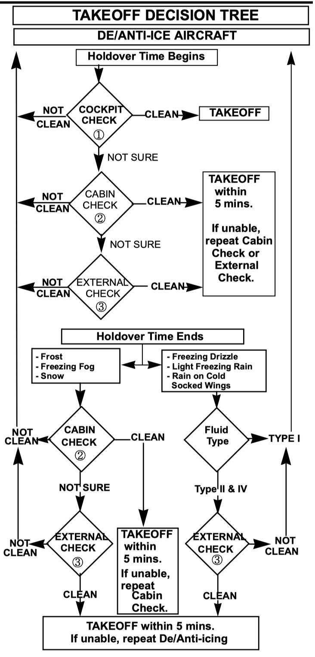
Home

Slide 70
ENG OFF Deicing in GMP...
KE GMP ”Deicing Information” REQ DCL Apron ”Req Pushback Deicing Required PADxxx”
PARKING BRAKE ---------------------- SET Establish communications with GND personnel. B737-8 BROADBAND SYS s/w ------- OFF FLAPS ------------------------------------ UP THRUST LEVERS ----------------------IDLE ENGINE BLEED AIR SWITCHES ----- OFF APU BLEED air switch ---------------- OFF
APU ---------------------------------- START APU GENERATOR bus switches ------ ON ENGINE ANTI-ICE switches----------- OFF Engine Start levers --------------- CUTOFF SHUTDOWN CHECKLIST
START DE/ANTI-ICING 항공기이동 및 Configuration 변경 금지
AFTER DE/ANTI-ICING IS COMPLETED (TIME CHECK 1분) 용액과 마지막 용액 뿌린 시간 받고 적는다. Holdover Time 결정!!!
TIME CHECK 1분후 APU BLEED air switch ----------------- ON PREFLT CHKlist -> Req STARTUP -> CHKlist
AFTER BOTH ENGINES ARE STARTED ENGINE ANTI-ICE switches----As needed B737-8 BROADBAND SYS s/w -------- ON APU------------------------------ As needed
Engine BLEED air switches ----------- ON FLAP LEVER ------- Set for takeoff or UP ice, snow, slush or standing water, 강수 지속시 – FLAP UP고려 Flight controls --------- Check, as needed AFTER START CHKlist (ATC CLR Confirm)
TAXI, BEFORE TAKEOFF, TAKEOFF cold wx 참조!!! DECISION TREE next page
Home

Slide 71
Home

Slide 72
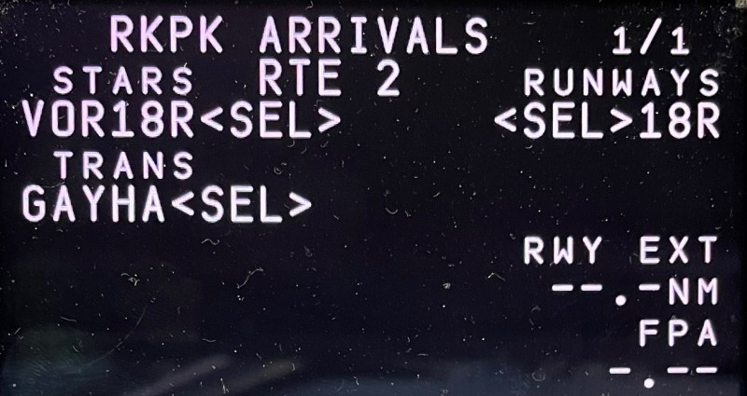
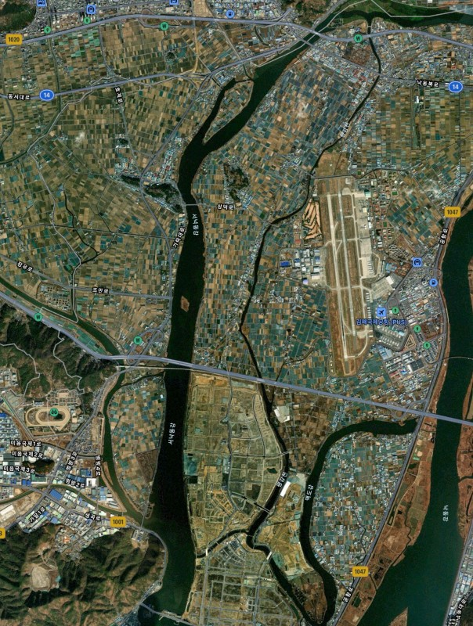
PUS VOR 18L/R
 | STARS RUNWAYS VOR18L/R 18L/R TRANS. KMH22 Vref+wind GAYHA (Modify Required)
FIX : KMH 280(Base Turn), 283(Missed App)
KMH32
KMH35
(18L)
KMH34
(18R)
KMH R280
Start Turn
H/D 182
090-1000ft
(900ft)
500’전
A/P Off
FD Off -
On
KMH30
H/D110
KMH30-1NM
Start Des
KMH22
(MA045)
1700ft L/O 6000ft SET
CRS 283
FAF
(FF045)
Before L/D CHK Complete
NEXT 1700ft
Missed App
Base Turn 이전 : L/H Turn KMH 283 OUTBD (SEL HDG SEL – INT H/D - VOR/LOC Engage)
Base Turn 이후 : Continue R/H Turn KMH 283 OUTBD (SEL HDG SEL – INT H/D - VOR/LOC Engage)
Home
LOC 36 Circling
Next Page

Slide 73
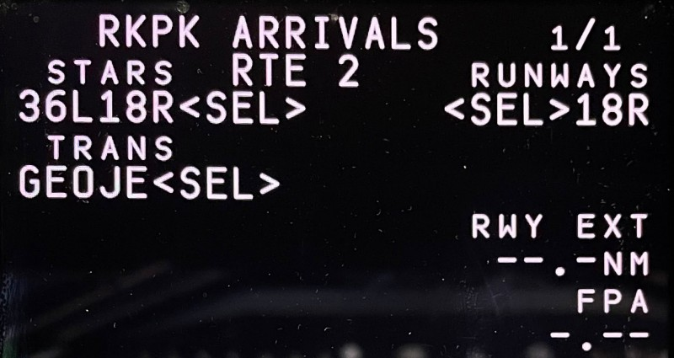
PUS LOC 36L/R Circling 18L/R
 | STARS RUNWAYS 36L18L/R 18L/R TRANS. KMH22 Vref+wind GEOJE (Modify Required)
CI36L(CF36R) 3500 FI36L(FF36R) 2100
FIX : KMH 280(Base Turn), 310(Missed App)
KMH32
KMH35
(18L)
KMH34
(18R)
KMH R280
Start Turn
H/D 182
090-1000ft
(900ft)
500’전
A/P Off
FD Off -
On
KMH30
H/D110
KMH30-1NM
Start Des
KMH22
VOR SET CRS 310
L/D FLAP
Before L/D CHK Complete
KMH18
Before FAF L/G DN FLAP15
1700ft L/O
6000ft SET
Missed App
Base Turn 이전 : L/H Turn KMH 310 OUTBD (SEL HDG SEL – INT H/D - VOR/LOC Engage)
Base Turn 이후 : Continue R/H Turn KMH 310 OUTBD (SEL HDG SEL – INT H/D - VOR/LOC Engage)
Home

Slide 74
GS KTS | KM | MILES
300 310 320 330 340 350 | 560 570 590 610 630 650 | 350 360 370 380 390 400
360 370 380 390 400 | 670 690 710 720 740 | 410 430 440 450 460
410 420 430 440 450 | 760 780 800 820 830 | 470 480 500 510 520
460 470 480 490 500 | 850 870 890 910 930 | 530 540 550 560 580
510 520 530 540 550 | 950 960 980 1000 1020 | 590 600 610 620 630
560 570 580 590 600 | 1040 1060 1070 1090 1110 | 650 660 670 680 690
610 620 630 640 650 | 1130 1150 1170 1190 1200 | 700 710 730 740 750
660 670 680 690 700 | 1220 1240 1260 1280 1300 | 760 770 780 800 810
Home

